Slide 1
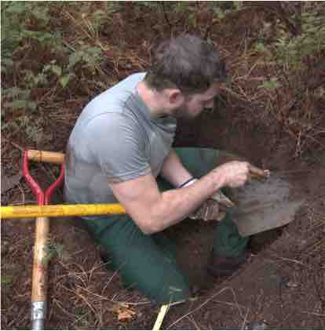
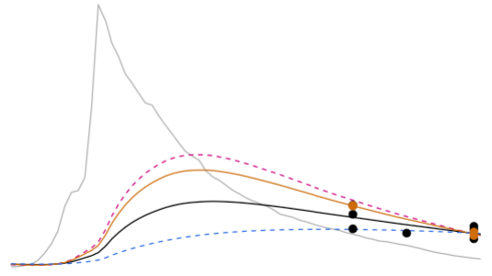
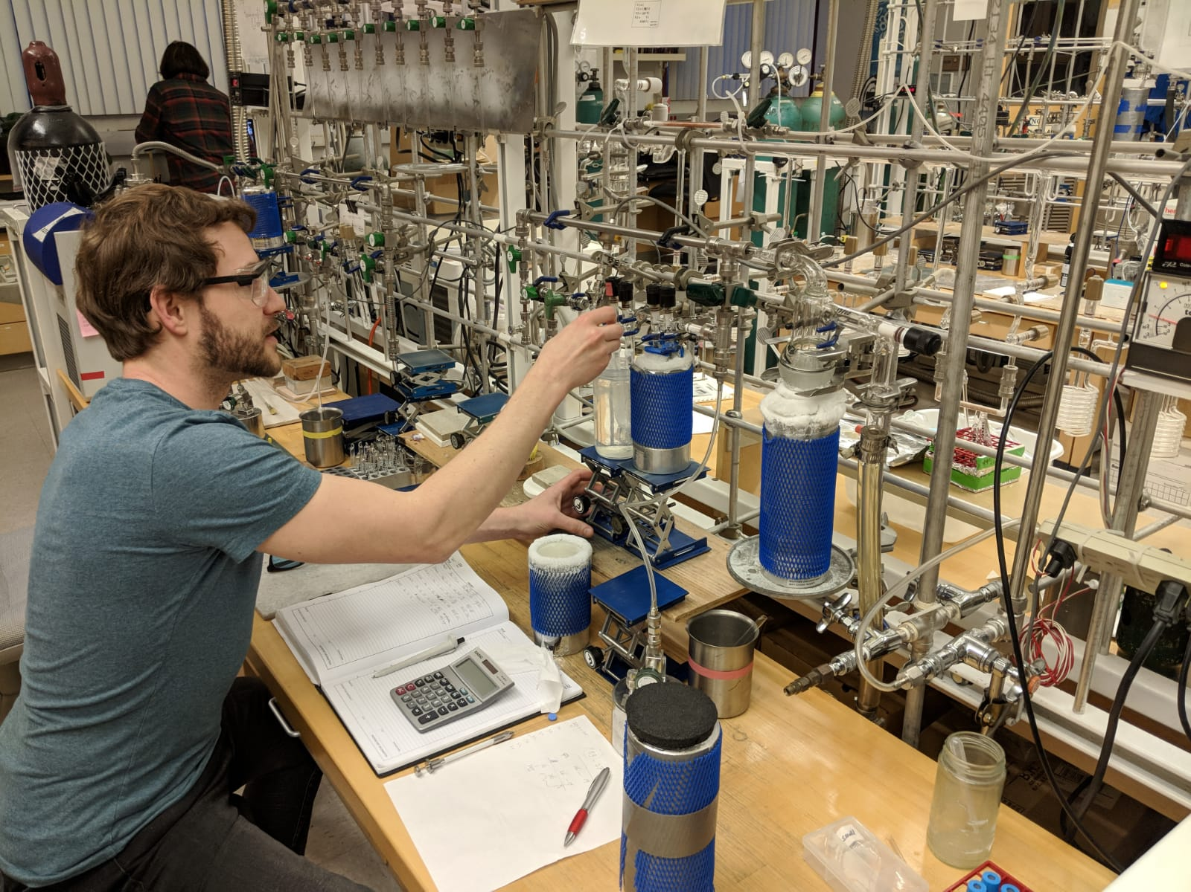



Radiocarbon constraints reveal time scales of soil carbon persistence
Jeff Beem-Miller, PhD
University of Michigan and Lawrence Berkeley National Laboratory
Forum Biogeochemistry and Landscape Dynamics 23 Oct., 2024
Beem-Miller FoBL Seminar
23 October 2024

Slide 2
OUTLINE
Parent material & climate impacts on soil C cycling
Site description and research questions
Modeling results
Implications for future soil C stocks

Slide 3
OUTLINE
Parent material & climate impacts on soil C cycling
Site description and research questions
Modeling results
Implications for future soil C stocks
Introduction to the Soil Warming Experiment to Depth Data Integration Effort (SWEDDIE)

Slide 4
OUTLINE
Parent material & climate impacts on soil C cycling
Site description and research questions
Modeling results
Implications for future soil C stocks
Introduction to the Soil Warming Experiment to Depth Data Integration Effort (SWEDDIE)
Next steps: 14C sampling at selected soil warming sites

Slide 5
CLIMATE CHANGE AND SOIL C
What drives soil C stock changes?
Notes:
So the question then becomes, how do we expect soil carbon stocks to change in the coming decades?

Slide 6
CLIMATE CHANGE AND SOIL C
inputs
+
What drives soil C stock changes?
+ decomposition
Notes:
So we have two competing pathways, one of which will lead to more storage of atmospheric CO2 in soils, the other of which will lead to soil carbon losses, potentially exacerbating warming
The positive pathway (in green) is driven by increases in carbon inputs to the soil
This is predicted to occur due to enhanced primary production in vegetation from both warming and increased atmospheric CO2 concentrations
The negative pathway (in red) predicts soil carbon losses due to increases in decomposition rates with warmer temperatures

Slide 7
CLIMATE CHANGE AND SOIL C
inputs
+
500
250
Change in soil C stocks by 2100
(Pg C)
0
-250
-500
+ decomposition
Ensemble of global soil C models
Model mean
Multi-model mean
± sd
(figure adapted from Todd-Brown et al., 2018)
Notes:
Unfortunately, current global soil carbon models do not agree on the relative importance of these two pathways
The figure here is from a synthesis paper by Kathe Todd-Brown and others, and shows predicted changes in global soil carbon stocks by the end of this century [under a high emissions scenario relative concentration pathway of 8.5]
It’s worth noting that all models predict substantial increases in inputs, by a relative factor of 1.4, which is why the mean change is positive
[Multi-model mean of this increase is: 88 ±153 Pg C]
However, there less agreement with regards to the increased decomposition pathway

Slide 8
CLIMATE CHANGE AND SOIL C
inputs
+
500
250
Change in soil C stocks by 2100
(Pg C)
0
-250
-500
+ decomposition
Ensemble of global soil C models
Model mean after adjusting temperature sensitivity (Q10)
Multi-model mean
± sd
(figure adapted from Todd-Brown et al., 2018)
Notes:
The authors of this study tried to improve the estimates of decomposition losses by rescaling the temperature sensitivity constant of decomposition in the models using data from soil warming experiments
What we can see is that after this rescaling, the multi-model mean declines [to 19 Pg C from 88 Pg C; similar sd]
But the overall picture is still one of confusion---the model estimates are all over the place
And this is partly because of the uncertainty about the temperature sensitivity of soil organic matter decomposition in the empirical data

Slide 9
SOIL C PERSISTENCE
What controls soil C persistence?
Notes:
So if we want to determine changes in soil carbon stocks due to increases in inputs or decomposition rates, we have to understand what controls soil carbon persistence

Slide 10
SOIL C PERSISTENCE
What controls soil C persistence?
persistence: the probability that a given atom of C in the soil will remain in the soil
Notes:
I’m using the term persistence here, which I am defining as the probability that a given atom of C in the soil will remain in the soil . You can also think of it as the opposite of decomposition

Slide 11
SOIL C PERSISTENCE
What controls soil C persistence?
Temperature
Notes:
OK, so we’ve already talked about how temperature affects decomposition rates: higher temperatures = faster decomposition and lower persistence

Slide 12
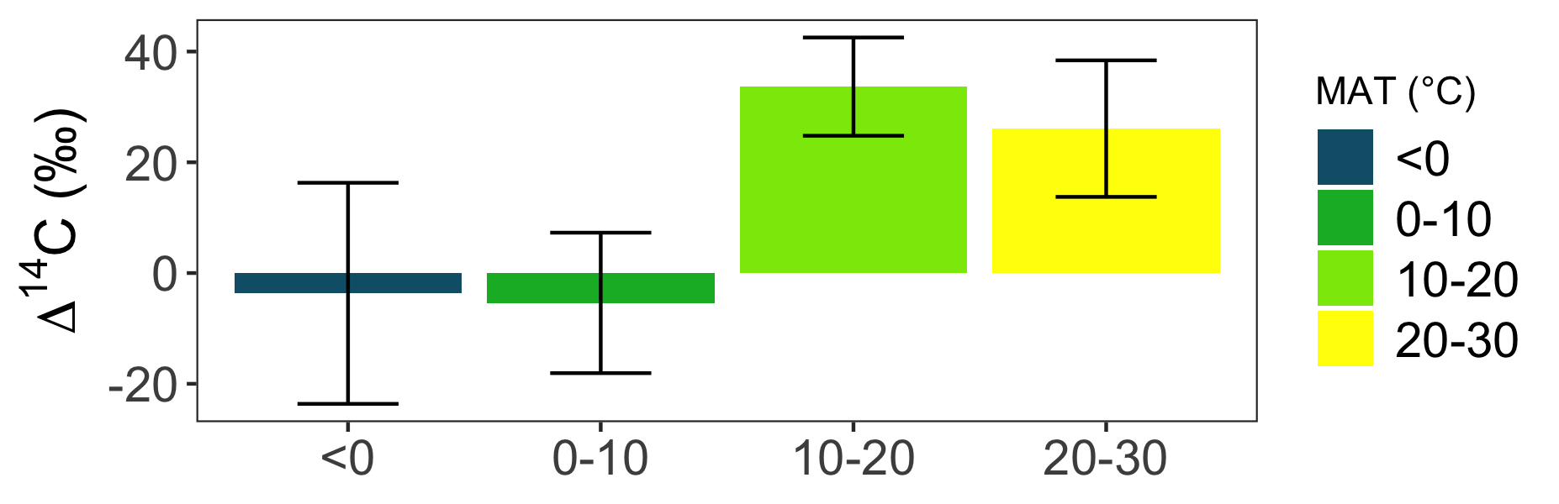
SOIL C PERSISTENCE
What controls soil C persistence?
Temperature
a)
MAT (°C)
Global distribution of ∆¹⁴C in soil (<0.3 m)
MAT = mean annual temperature
(Data from ISRaD) assemblage
Notes:
We can see this clearly when we group bulk soil radiocarbon values by mean annual temperature
These data from from the International Soil Radiocarbon Database, or ISRaD, which I helped build during my PhD and now maintain
So what we can see here is that ∆14C values for colder climate soils are negative values, indicating longer persistence, while warmer soils have positive values, which indicates that the majority of carbon in these soils is cycling on annual to decadal time scales
However, we can also see a lot of variation in these boxes, and one of the reasons is that the minerals present in the soil also have a strong impact on soil carbon persistence
plots in file “israd_dynaminx.R”

Slide 13
SOIL C PERSISTENCE
What controls soil C persistence?
Temperature
Soil minerals
a)
MAT (°C)
Global distribution of ∆¹⁴C in soil (<0.3 m)
MAT = mean annual temperature
(Data from ISRaD) assemblage
Notes:
This is for two main reasons:
The first is that decomposition is less likely to occur if the decomposer organisms need to use a lot of energy to break the bonds between mineral and organic matter particles
The second is that minerals can prevent physical contact between decomposer organisms and soil organic matter particles
This mineralogical effect on soil carbon persistence is mainly a function of highly reactive minerals, meaning those with high surface area and charge

Slide 14
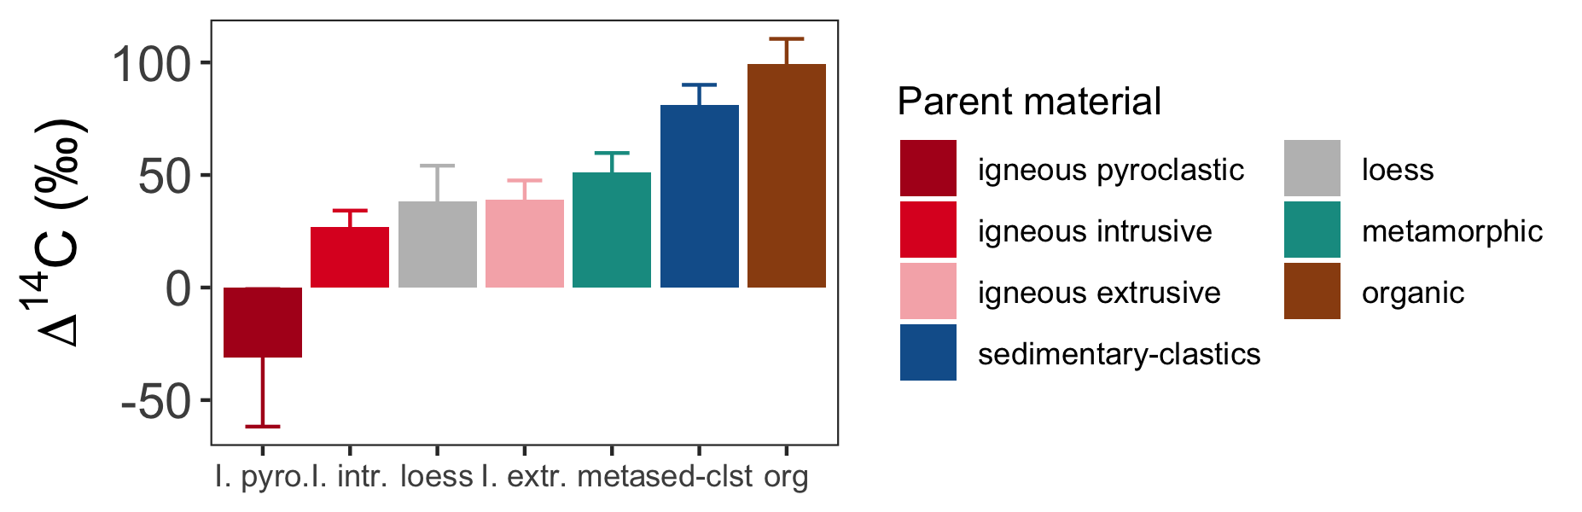
SOIL C PERSISTENCE
What controls soil C persistence?
Temperature
Soil minerals
a)
MAT (°C)
b)
Parent material
Global distribution of ∆¹⁴C in soil (<0.3 m)
MAT = mean annual temperature
(Data from ISRaD) assemblage
Notes:
We can see this mineralogical effect if we group the data by parent material, which has a strong influence on the abundance of reactive minerals in soil

Slide 15
RESEARCH QUESTIONS
Do soil mineral assemblages affect temperature sensitivity of soil carbon persistence?

Slide 16
RESEARCH QUESTIONS
Do soil mineral assemblages affect temperature sensitivity of soil carbon persistence?
On which time scales are soil mineral assemblages relevant for predicting soil carbon persistence?
Notes:
Do minerals only matter for slowly cycling soil C? Or are they also relevant for soil carbon cycling on annual to decadal time scales?

Slide 17
RESEARCH QUESTIONS
Do soil mineral assemblages affect temperature sensitivity of soil carbon persistence?
On which time scales are soil mineral assemblages relevant for predicting soil carbon persistence?
Can we improve predictions soil carbon stock changes in response to rising temperatures by incorporating information about soil assemblages?

Slide 18
METHODS

Slide 19
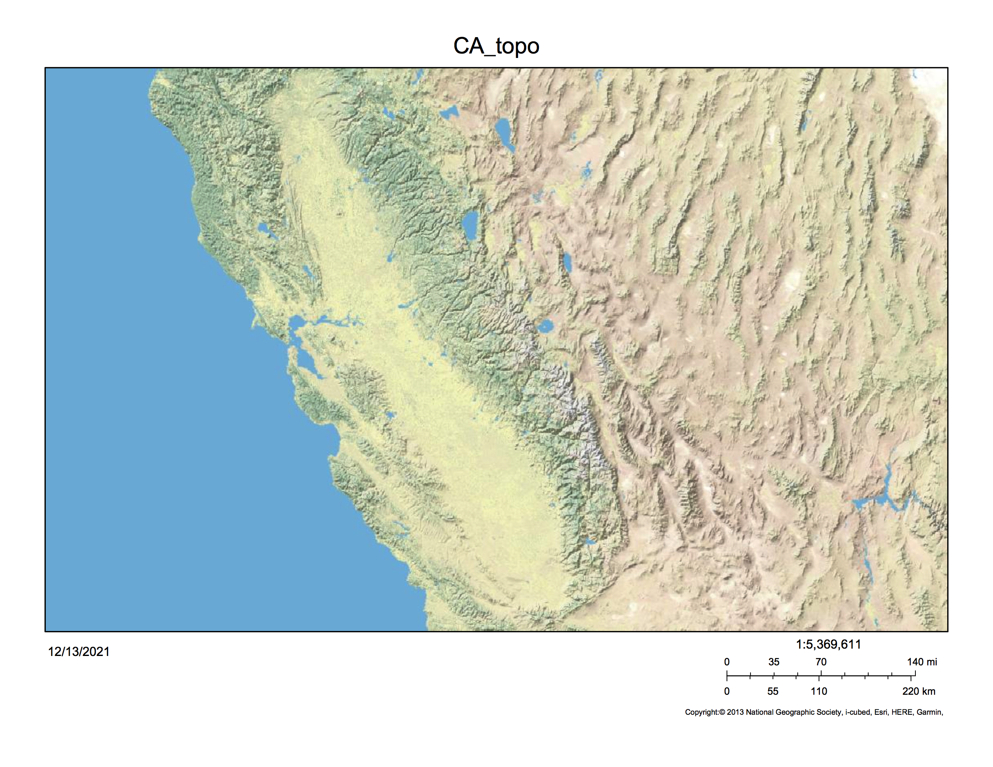
STUDY SITES
San Francisco
100 km
Sierra Nevada Mtns, California, USA
cf. Rasmussen 2004; Rasmussen et al., 2006; 2007; 2008; 2010; 2018
Notes:
Sites established by my colleague Craig Rasmussen

Slide 20
STUDY SITES
100 km
Notes:
North to south parent material gradient, temperature gradient with elevation
Archived soils available from previous work by Craig Rasmussen and colleagues, and this was critical for constructing a radiocarbon time series, which I will talk more about in a minute

Slide 21
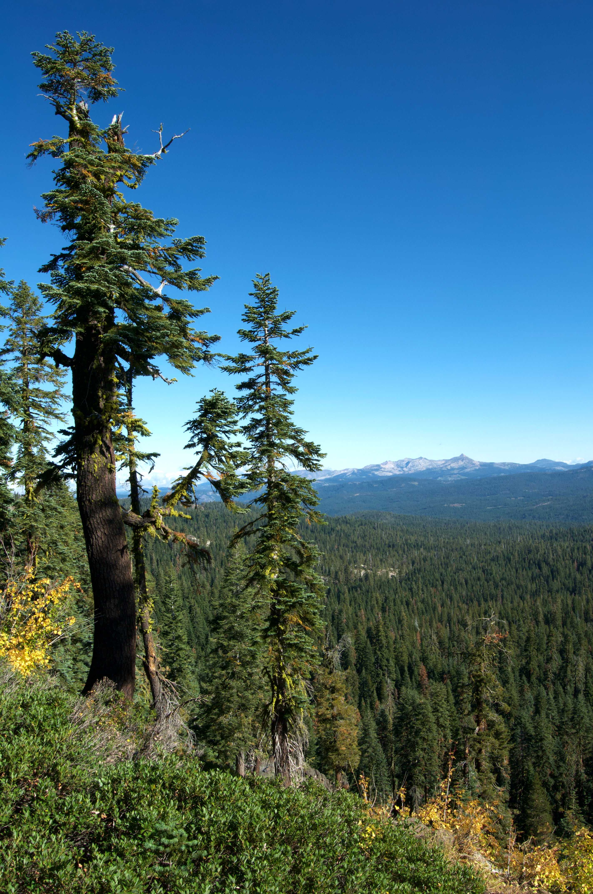
STUDY SITES
100 km
Mixed conifer biome
Notes:
So the other advantage of these sites is the consistency of the vegetation, which is all classified as the California mixed conifer biome

Slide 22
STUDY SITES
Basalt
Andesite
Granite
100 km
Notes:
As I mentioned the parent material changes from north to south, with basaltic soils in the north, andesitic soils in the middle, and granitic soils to the south
Soil mineral assemblages change substantially with parent material, but also with temperature and elevation
I know this because Rasmussen and colleagues characterized the soils thoroughly using a combination of selective dissolution and quantitative x-ray powder diffraction

Slide 23
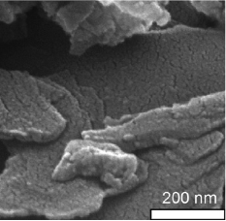
STUDY SITES
pyrophyllite
Basalt
1:1 phyllosilicates, 2:1 clays & SRO
Andesite
Granite
100 km
Images from Mikutta et al., 2007
Notes:
The basaltic soils are dominated by kaolinite in lower elevation, warm climate zone
[picture shows pyrophyllite, which has similarly neutral siloxane surfaces]
interlayered 2:1 clays (smectite and vermiculite) at higher elevation sites
Moderate abundance of short range order iron and aluminum hydroxides and oxyhydroxides

Slide 24
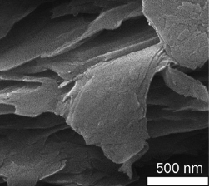
STUDY SITES
pyrophyllite
Basalt
1:1 phyllosilicates, 2:1 clays & SRO
vermiculite
Andesite
2:1 clays, SRO & allophane
Granite
100 km
Images from Mikutta et al., 2007
Notes:
interlayered 2:1 clays (smectite and vermiculite)
Abundant short range order iron and aluminum hydroxides and oxyhydroxides
also substantial amounts of allophane in the higher elevation sites

Slide 25
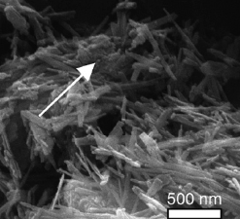
STUDY SITES
pyrophyllite
Basalt
1:1 phyllosilicates, 2:1 clays & SRO
vermiculite
Andesite
2:1 clays, SRO & allophane
Granite
1:1 phyllosilicates & crystalline Fe (oxy)hydroxides
goethite
100 km
Images from Mikutta et al., 2007
Notes:
predominately kaolinite and some non-expanding 2:1 clays
crystalline phase iron oxides
[I am showing goethite here as an example, although the mineralogical characterization of these soils only found trace amounts of goethite]

Slide 26
STUDY SITES
Basalt
Andesite
Granite
100 km
Notes:
OK, so what do these soils look like?

Slide 27
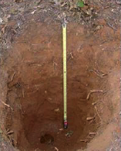
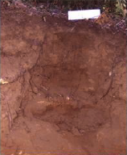
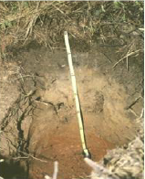
STUDY SITES
WARM
Basalt
Andesite
Granite
100 km
Notes:
highly weathered, warm climate sites

Slide 28
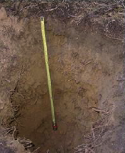
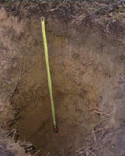
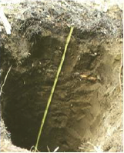
STUDY SITES
WARM
COOL
Basalt
Andesite
Granite
100 km
Notes:
moderately developed cool climate soils, rich in secondary minerals

Slide 29
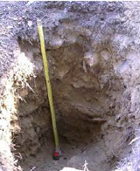
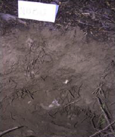
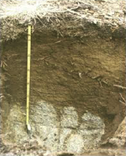
STUDY SITES
WARM
COOL
COLD
Basalt
Andesite
Granite
100 km
Notes:
young, shallow, rocky soils, rich in primary minerals

Slide 30
STUDY SITES
9 sites
Basalt
Andesite
Granite
100 km

Slide 31
STUDY SITES
9 sites
3 sampling years (2001, 2009, 2019)
Basalt
Andesite
Granite
100 km

Slide 32
STUDY SITES
9 sites
3 sampling years (2001, 2009, 2019)
3 depths (0-0.1 m, 0.1-0.2 m, 0.2-0.3 m)
Basalt
Andesite
Granite
100 km

Slide 33
STUDY SITES
9 sites
3 sampling years (2001, 2009, 2019)
3 depths (0-0.1 m, 0.1-0.2 m, 0.2-0.3 m)
Analyses:
%C and %N
density fractions (free light, occluded light, heavy)
∆¹⁴C (bulk soil, respired CO2, density fractions)
Basalt
Andesite
Granite
100 km
Notes:
density fractionation in order to quantify the mineral associated soil organic matter pool
Laboratory soil incubations key tool [next]

Slide 34
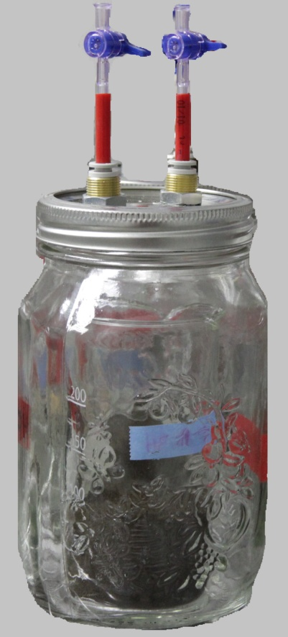
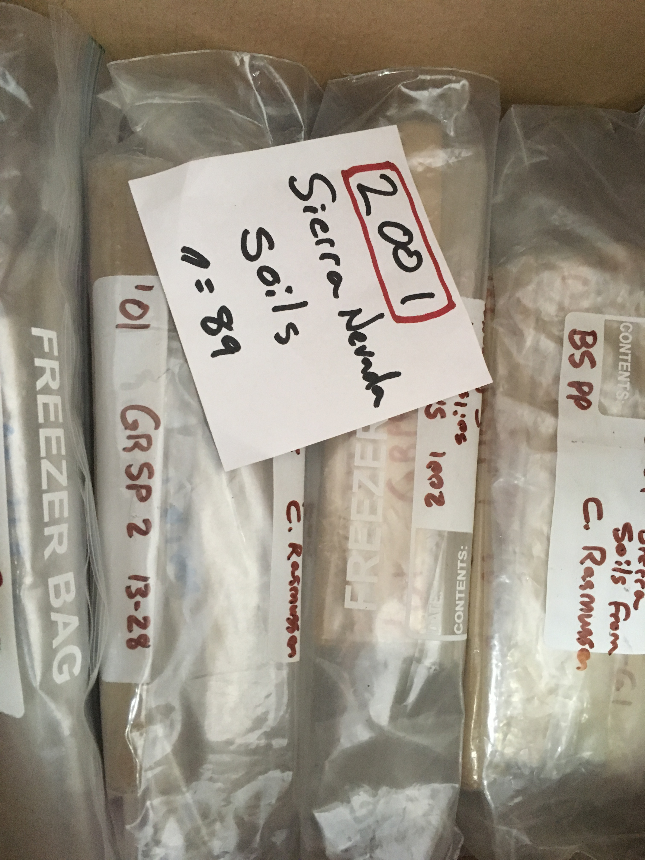
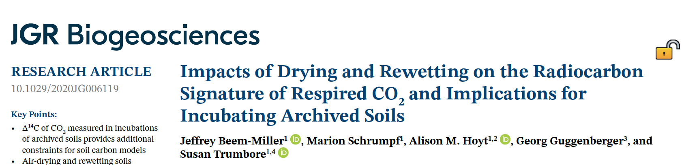
STUDY SITES
9 sites
3 sampling years (2001, 2009, 2019)
3 depths (0-0.1 m, 0.1-0.2 m, 0.2-0.3 m)
Analyses:
%C and %N
density fractions (free light, occluded light, heavy)
∆¹⁴C (bulk soil, respired CO2, density fractions)
Basalt
Andesite
Granite
100 km
Notes:
density fractionation in order to quantify the mineral associated soil organic matter pool
Time series of respired CO2 and bulk soil C 14C are key constraints for the soil carbon modeling work I did

Slide 35
STUDY SITES
9 sites
3 sampling years (2001, 2009, 2019)
3 depths (0-0.1 m, 0.1-0.2 m, 0.2-0.3 m)*
Analyses:
%C and %N
density fractions (free light, occluded light, heavy)
∆¹⁴C (bulk soil, respired CO2, density fractions)
Additional data (Rasmussen et al.):
selective dissolution
clay mineralogy
Basalt
Andesite
Granite
100 km
cf. Rasmussen 2004; Rasmussen et al., 2006; 2007; 2008; 2010; 2018

Slide 36

THE RADIOCARBON TRACER
¹⁴C
Notes:
Radiocarbon has two key properties that make it ideal as a tracer:
1) it is a rare isotope, making up only 1 in 1 trillion atoms of carbon in the pre-industrial atmosphere, and
2) it undergoes radioactive decay

Slide 37
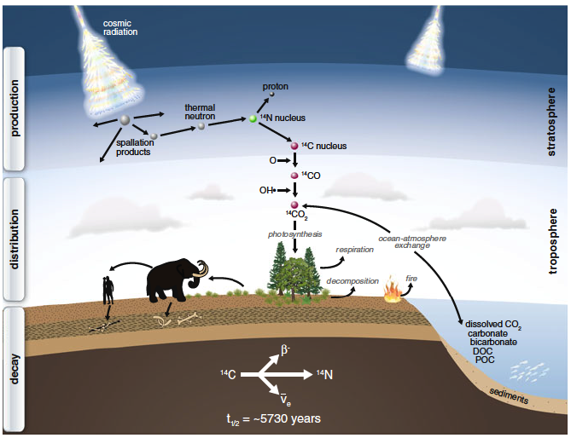
THE RADIOCARBON TRACER
¹⁴C
(figure from Schuur et al., 2016)
Notes:
Radiocarbon is naturally produced in the stratosphere by high energy incoming cosmic rays, and as soon as this atmospheric carbon is fixed, such as by a plant, it begins to decay, with a half-life around 6000 years.
Because of this relatively long half life, this technique of radiocarbon dating is useful on centennial and longer time scales

Slide 38
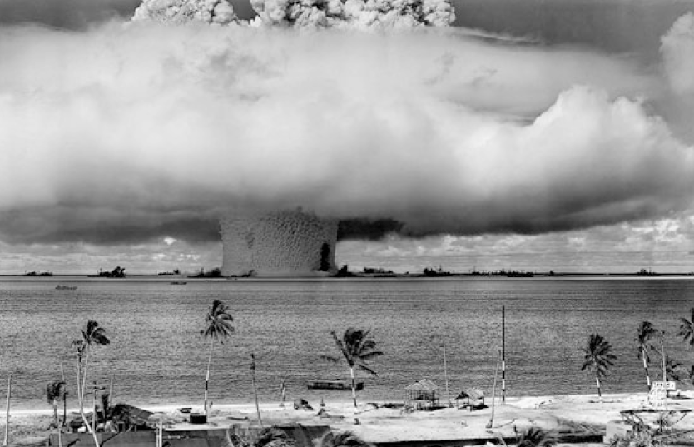
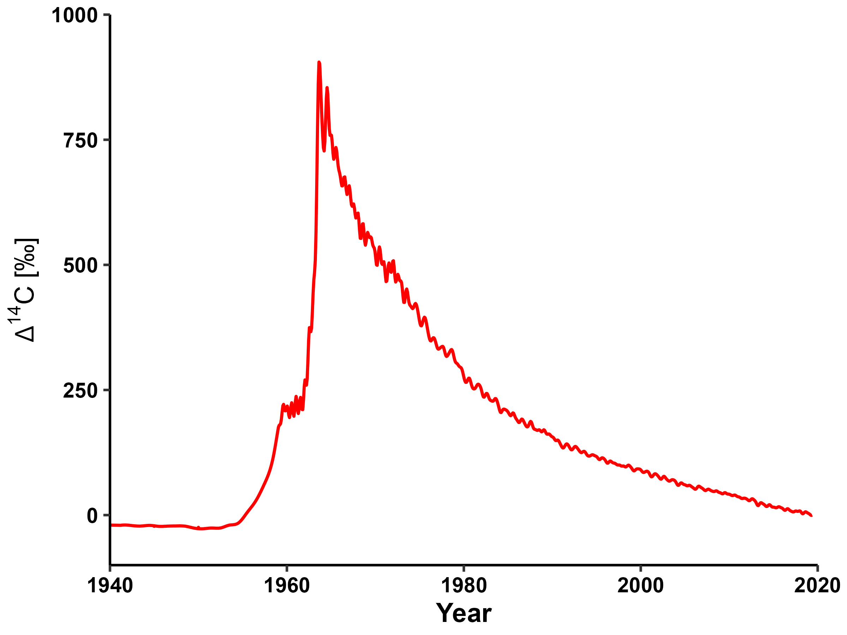
THE RADIOCARBON TRACER
(figure from S. von Fromm)
Notes:
But cosmic rays are not the only way to generate radiocarbon
Atmospheric radiocarbon concentrations nearly doubled over the course of the 20th century as a consequence of nuclear weapons testing
Following the ban on aboveground testing, the concentration began to decline as this bomb-C label was taken up by ecosystems
The key point here is that the relatively rapid rate of decline seen here enables organic material to be dated with nearly annual precision

Slide 39
THE RADIOCARBON TRACER
“bomb-C” useful for tracing soil C cycling on short (1-10¹) time scales
cosmogenic ¹⁴C useful for time scales >10²
(figure from S. von Fromm)
Notes:
So to sum up:

Slide 40

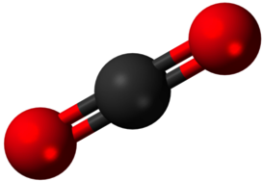
COMPARTMENTAL MODELS
IN
OUT
Notes:
The other main tool I used in my PhD work is compartmental modeling
Soil is an open system, meaning it both constantly receives new carbon inputs while simultaneously releasing carbon back to the atmosphere
Because of this we need a model in order to determine soil carbon persistence from radiocarbon

Slide 41
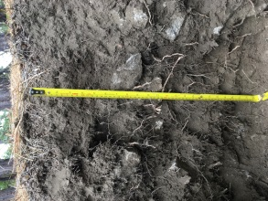
COMPARTMENTAL MODELS
IN
Bulk soil ∆¹⁴C
~
Respired ∆¹⁴C-CO₂
~
OUT
age
transit time
soil C age: age of particles in the soil
soil C transit time: age of particles in the release flux
Notes:
The two main measurements I used to constrain these compartmental models are the 14C of bulk soil and respired CO2
These two measurements tell us different things, with bulk soil 14C corresponding to the mean age of carbon in the soil, and respired radiocarbon corresponding to the age of carbon leaving the soil, or the soil carbon transit time

Slide 42
COMPARTMENTAL MODELS
Bulk soil ∆¹⁴C
~
IN
Respired ∆¹⁴C-CO₂
~
OUT
FAST
age
transit time
SLOW
out
C-mass weighted
C-flux weighted
Notes:
Soils are heterogeneous, meaning that they are characterized by multiple pools turning over at different rates,
Because of this, these two signals are different because bulk soil radiocarbon is driven by mass-weighted average of carbon in each pool, and respired radiocarbon is weighted by their relative contribution to the total flux of carbon leaving the soil

Slide 43
COMPARTMENTAL MODELS
IN
OUT
FAST
SLOW
out
Notes:
From a modeling perspective, we can represent this system with three parameters

Slide 44
COMPARTMENTAL MODELS
IN
2-pool parallel
OUT
FAST
k1
Out
SLOW
In
𝛾
out
k2
Notes:
the turnover rates for each of the pools (k1, k2) and a third parameter-–labeled gamma here---that tells us what proportion of the inputs is allocated to each pool

Slide 45
COMPARTMENTAL MODELS
IN
2-pool parallel
OUT
FAST
k1
Out
SLOW
In
𝛾
out
k2
+ Lag
Notes:
I also considered a fourth parameter in my models which is a lag time
this accounts for the fact that the carbon entering the system is commonly “pre-aged”---either in upper soil horizons or in vegetation

Slide 46
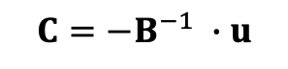
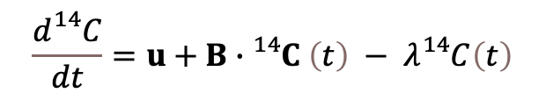
PARAMETER OPTIMIZATION
$$\frac{d{}_{}^{14}C}{dt}=u+B∙{}_{}^{14}C \left(t\right) − λ{}_{}^{14}{C\left(t\right)}$$
Approach:
SoilR
steady-state (input = output)
$$C={−B}^{−1} ∙u$$
SoilR: Sierra et al., 2014
Notes:
Using the SoilR package, developed by my colleague Carlos Sierra and others, we can represent this compartmental model as a system of linear differential equations
For this work I assumed that the soils are at steady-state, which is borne out by the fact that I did not observe any notable changes in measured soil carbon stocks or soil carbon concentrations between 2001 and 2019

Slide 47
PARAMETER OPTIMIZATION
Approach:
SoilR
steady-state (input = output)
Constraints:
∆¹⁴C time series (bulk soil & respired CO₂)

Slide 48
PARAMETER OPTIMIZATION
Approach:
SoilR
steady-state (input = output)
Constraints:
∆¹⁴C time series (bulk soil & respired CO₂)
Optimization:
initial analytical algorithm fit
10,000 MCMC runs
AIC to select best-fit model (2-pool parallel)
solve for inputs with known stocks
Notes:
Markov Chain Monte Carlo simulation
An advantage of the MCMC approach is that it generates more robust parameter estimates, but also quantifies the uncertainty of the estimate
I also considered several other model structures, but for reasons I can explain later, I selected the 2-pool parallel structure for reasons of performance (fit to data) and simplicity
Finally, because steady-state assumed, I was able to estimate the inputs using the optimized parameter set and the measured stocks
This is not trivial because belowground inputs are hard measure empirically

Slide 49
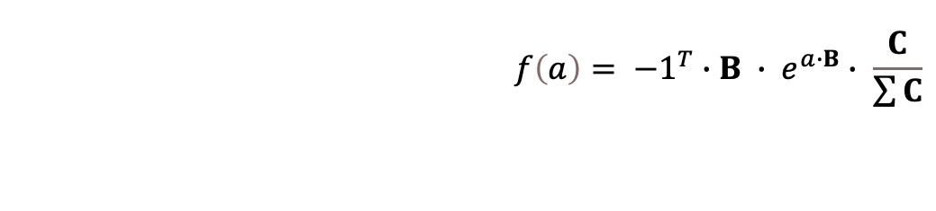
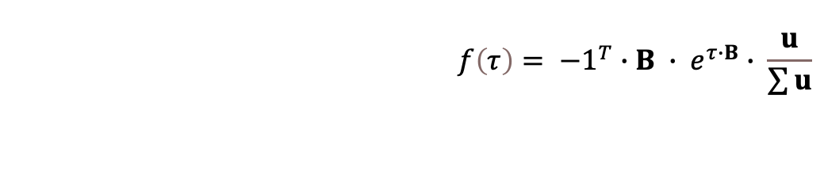
AGES & TRANSIT TIMES
Probability distribution functions:
Age
Transit time
$$f\left(a\right)= {−1}^{T}∙B ∙ e^{a∙B}∙ \frac{C}{\sum{C}}$$
$$f\left(τ\right)= {−1}^{T}∙B ∙ e^{τ∙B}∙ \frac{u}{\sum{u}}$$
See Metzler et al., 2018 for derivation of these formulae
Notes:
Once I determined the optimal parameter sets, I was able to estimate the probability distributions for soil carbon ages and transit times using the formulas derived by my colleagues Holgar Metzler and Carlos Sierra
Going beyond the mean ages and transit times and calculating the full probability distribution functions is an important step, and I will return to this point later

Slide 50
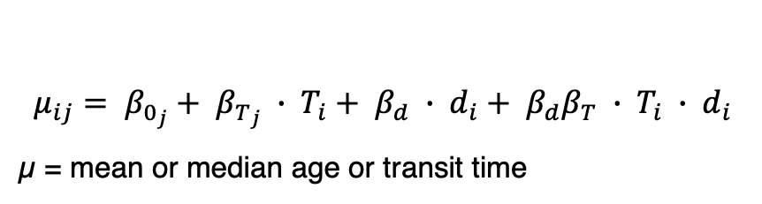
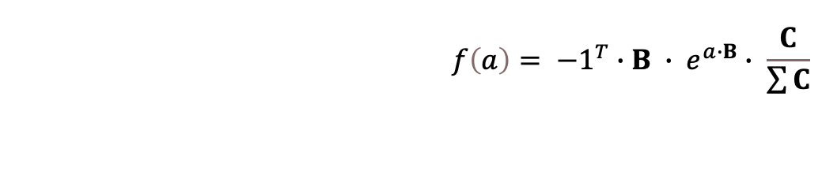
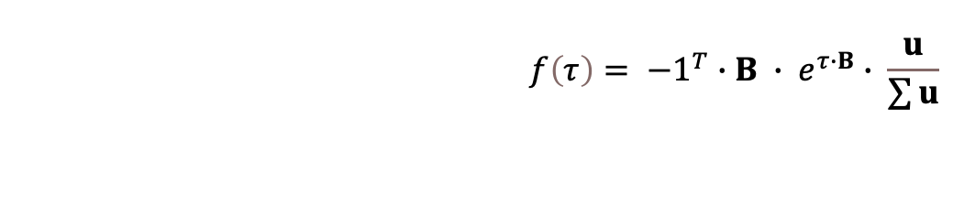
AGES & TRANSIT TIMES
Probability distribution functions:
Age
Transit time
Generalized Bayesian linear models:
$$f\left(a\right)= {−1}^{T}∙B ∙ e^{a∙B}∙ \frac{C}{\sum{C}}$$
$$f\left(τ\right)= {−1}^{T}∙B ∙ e^{τ∙B}∙ \frac{u}{\sum{u}}$$
$$μ_{ij}= β_{0_{j}}+ β_{T_{j}} ∙ T_{i}+ β_{d} ∙ d_{i}+ β_{d}β_{T} ∙ T_{i} ∙ d_{i}$$
µ = mean or median age or transit time
Covariates:
T (mean annual temperature)
d (depth)
OX (reactive minerals)
Notes:
Finally, I used a generalized Bayesian linear modeling framework to assess the relationship between ages and transit times and temperature and soil mineralogy
[I selected this approach as it allowed me to use the variance observed in ages and transit times from the MCMC runs to inform the model priors]
[another advantage is that considering the posterior distribution of the linear model parameters improves uncertainty estimates for sparse datasets]

Slide 51
RESULTS:
Ages & transit times
Notes:
OK, so now I will go over the bulk and respired 14C time series data, as well as the relationship of temperature and soil mineralogy to soil carbon ages and transit times

Slide 52
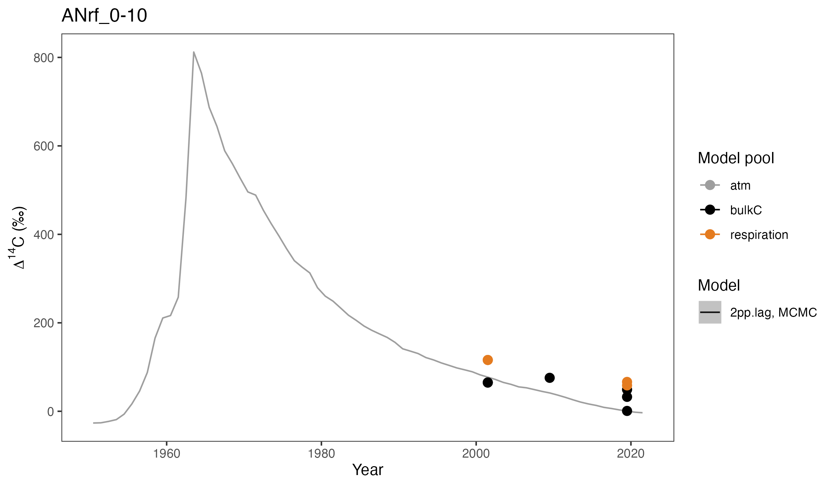
RADIOCARBON TIME SERIES
Notes:
Example of time series data (cold climate andesite, 0-10cm)
bomb-C curve in background

Slide 53
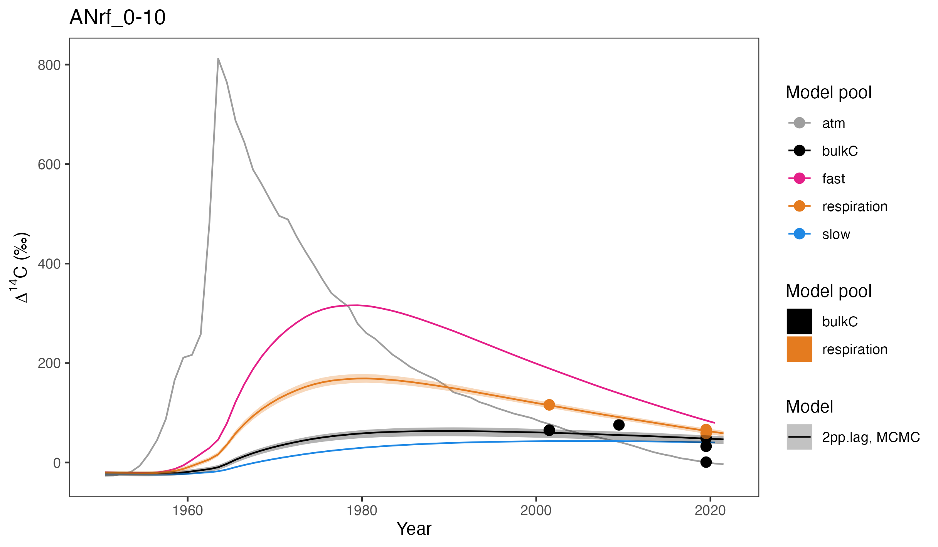
RADIOCARBON TIME SERIES
Notes:
We can see that the model fits the data pretty well, and this was the case for most of the sites
I will focus first on the bulk and respired 14C data and then on the model estimates for ages and transit times
In the next section I will address the interpretation of the pool dynamics---shown here in pink and blue

Slide 54
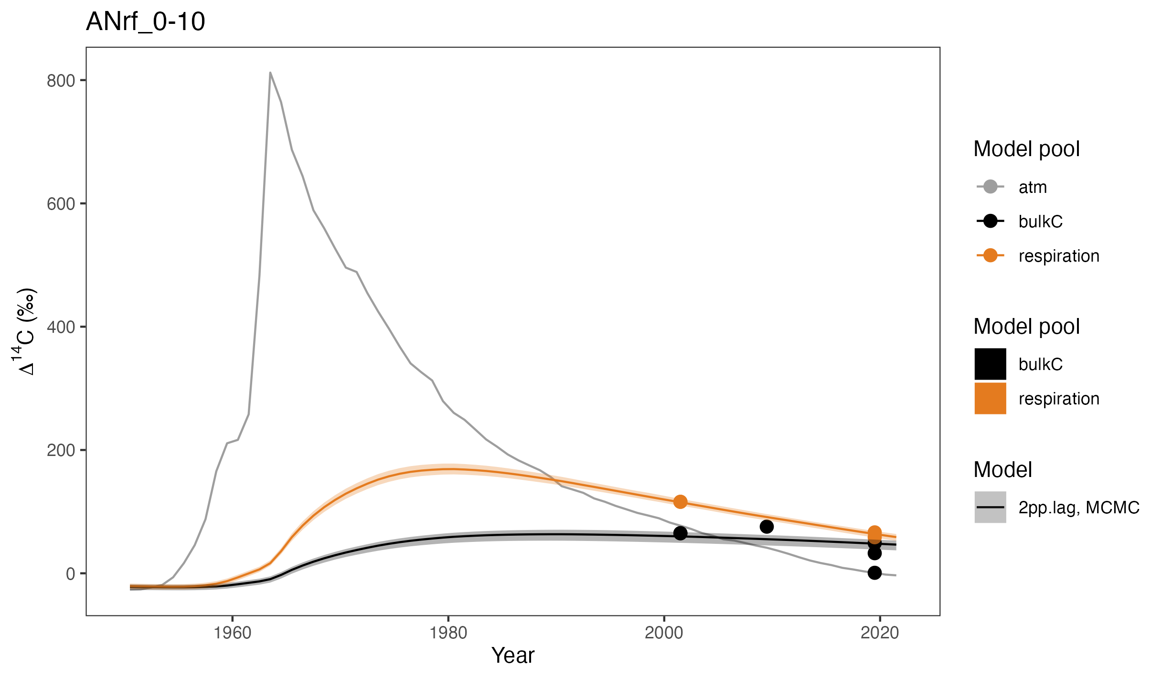
RADIOCARBON TIME SERIES
Notes:
To orient you, just a heads-up that for the next few slides I will be zooming in on this time period here---from 2001 to 2019

Slide 55
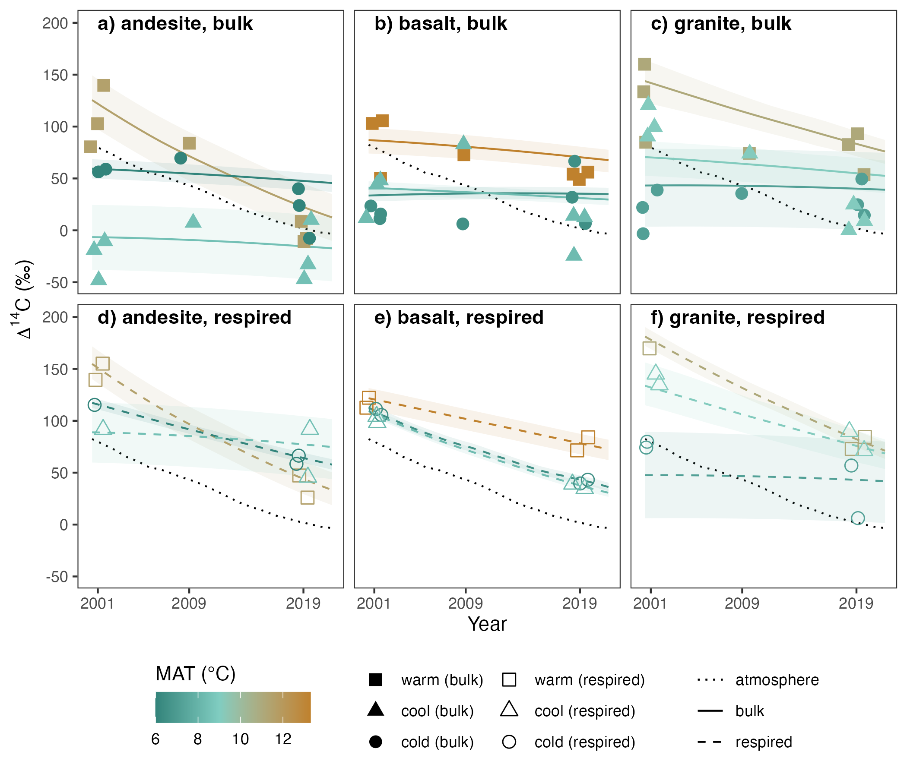
BULK SOIL ∆¹⁴C
0-0.1 m
∆¹⁴C
Notes:
OK, so let’s start with bulk soil 14C
(explain axes, lines, etc.)
Here we are looking at the andesitic soils, and we can see immediately that the trajectory of bulk soil 14C over this time period is quite different for the different climate zones
we see the most change over time in the warm climate zone, in brown, which tells us that soil carbon at this site is cycling faster than at the other sites
if we look at the actual ∆14C values, we can also see that the cool climate site has the oldest carbon, followed by the cold climate site, and the warm climate site is the youngest
I also want to point out that while the 14C of the cold climate site does not change much over the time period shown here, the ∆14C values are above zero, indicating the presence of bomb-C, which tell us the majority of the carbon in the soil is cycling on decadal time scales

Slide 56
BULK SOIL ∆¹⁴C
0-0.1 m
∆¹⁴C
Notes:
OK, moving on to the basaltic soils
Here we see a similar pattern in terms of the relative age of carbon with respect to climate, with the youngest carbon being found in the warm climate soils
However, unlike in the andesitic soils, here we see that the age of carbon in the cool and cold climate soils appear pretty much indistinguishable

Slide 57
BULK SOIL ∆¹⁴C
0-0.1 m
∆¹⁴C
Notes:
Turning to the granitic soils, we can see the strongest relationship with climate
here the warm climate soils are again the youngest, followed by the cool climate soils, and then the cold climates, which is the expected canonical relationship

Slide 58
BULK SOIL ∆¹⁴C
0-0.1 m
∆¹⁴C
Parent material affects the temperature sensitivity of bulk ∆¹⁴C
Greatest differences among parent materials seen at the cool climate sites
Notes:
So to summarize, we can say that parent material affects temperature sensitivity of bulk soil ∆¹⁴C, and also that we see the greatest differences among parent materials at the cool climate sites, so there’s something special going on there

Slide 59
RESPIRED ∆¹⁴C-CO₂
0-0.1 m
∆¹⁴C
Notes:
OK, let’s turn to the respired 14C data
Starting again with the andesitic soils, we can see that the fastest rate of change is seen in the warm climate soils
And what’s more, the slope of this change mimics the slope seen for the atmosphere, suggesting a strong contribution of annually cycling soil carbon
In contrast, we see the least amount of change in the cool climate soils, similar to the bulk soil
But unlike the bulk soil 14C, here we see that the ∆14C values for all three climate zones are positive, which tells us that the majority of carbon leaving the soil is cycling on annual to decadal time scales

Slide 60
RESPIRED ∆¹⁴C-CO₂
0-0.1 m
∆¹⁴C
Notes:
For the basalts we much less variation with climate in terms of both the slopes and the actual ∆14C values
We can also see that the rate of decline appears only slightly slower than what we observe in the atmosphere

Slide 61
RESPIRED ∆¹⁴C-CO₂
0-0.1 m
∆¹⁴C
Notes:
Looking at the granite soils---which have the lowest abundance of reactive minerals---we see again the strongest temperature response, with the slope decreasing with decreasing temperature

Slide 62
RESPIRED ∆¹⁴C-CO₂
0-0.1 m
Parent material affects the temperature sensitivity of respired ∆¹⁴C
∆¹⁴C
Notes:
So to summarize, we can say that just as with bulk soil 14C, parent material also appears to affect the temperature sensitivity of respired 14C

Slide 63
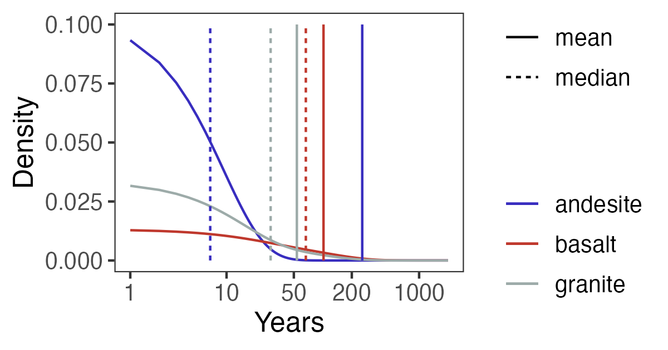
PROBABILITY DISTRIBUTIONS
a) warm, age
0-0.1 m
Notes:
OK, so now I want to explain in a bit more detail what it means to have distributions of soil C ages and transit times
I’m showing the distributions from the warm climate site just as an example here---you’ll see all of the data in a minute
The key point I want to make here is that for all of the soils median ages are younger than mean ages---and substantially so in the case of the andesitic soil here
What this means is that for most soils, or certainly the majority of the soils in this study, the mean is skewed small amounts of very old carbon and therefore median does a better job of describing the central tendency of the data

Slide 64
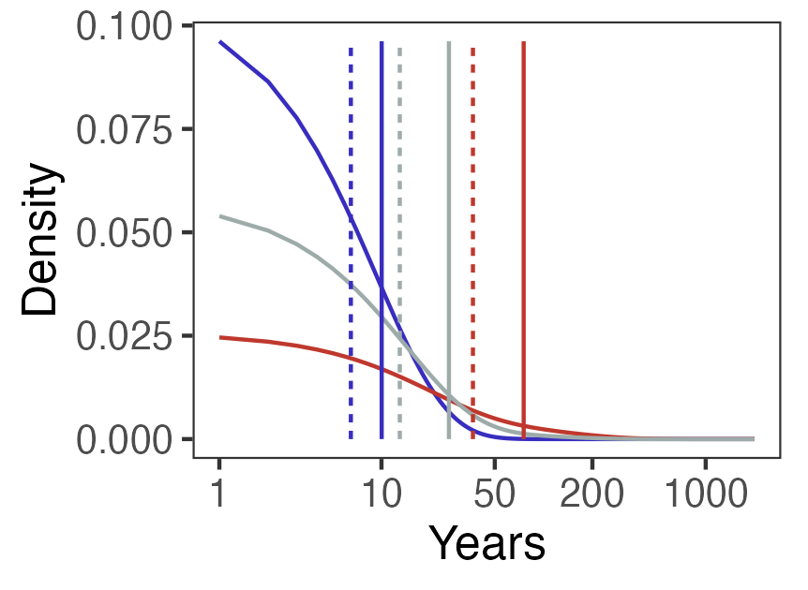
PROBABILITY DISTRIBUTIONS
b) warm, transit time
0-0.1 m
Notes:
Here you can see what these distributions look like for transit time
Don’t focus too much on the details here, I just wanted to point out that the transit time distributions have a similar shape to the age distributions, insofar as the median is always smaller than the mean

Slide 65
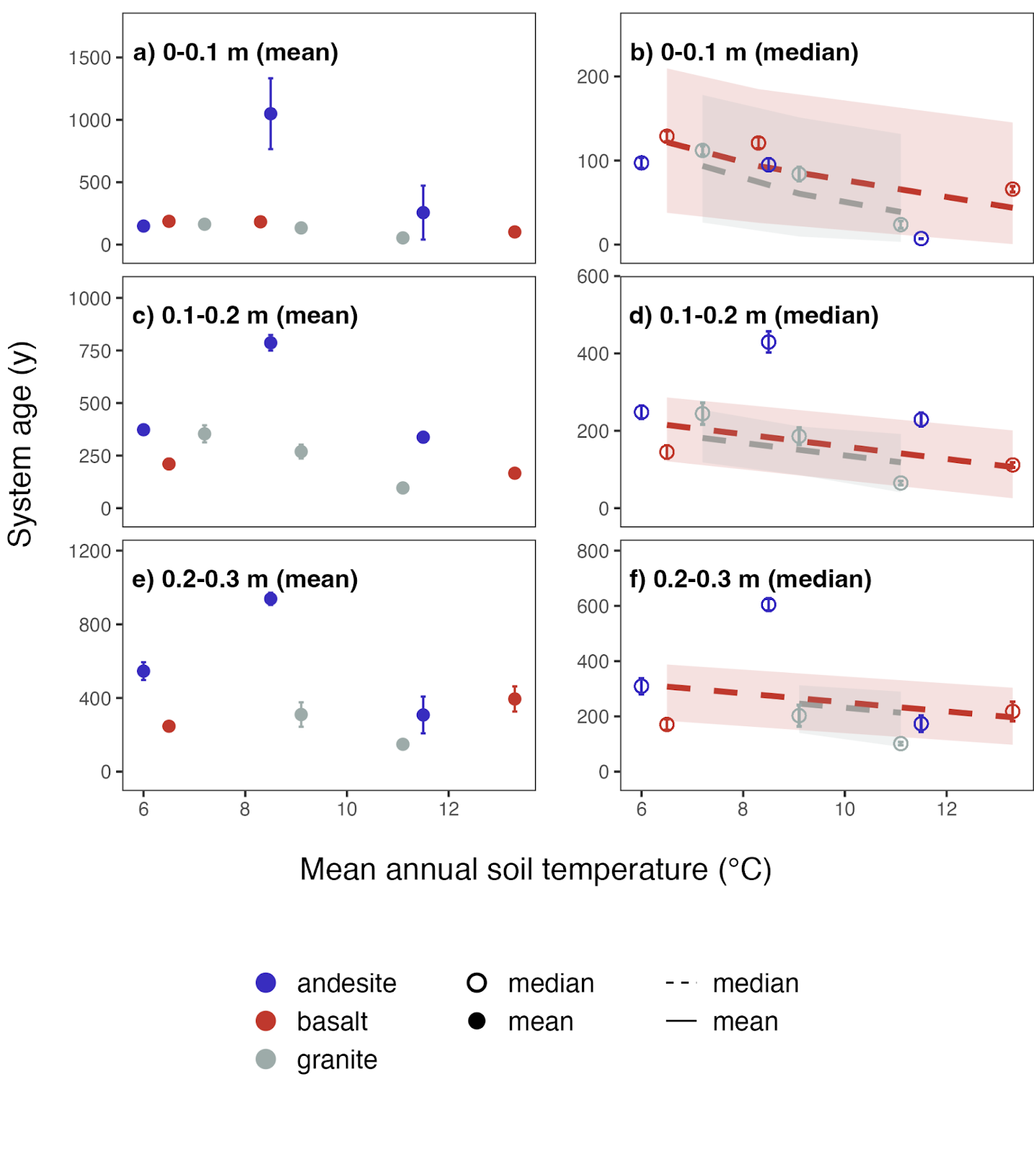
TEMPERATURE & SYSTEM AGE
age (y)
Notes:
OK, so now let’s look at how these mean and median ages and transit times relate to temperature and mineralogy

Slide 66
TEMPERATURE & SYSTEM AGE
age (y)

Slide 67
TEMPERATURE & SYSTEM AGE
Mineralogical factors appear more important than temperature for predicting mean system C ages
Median system C age more responsive to temperature than mean

Slide 68
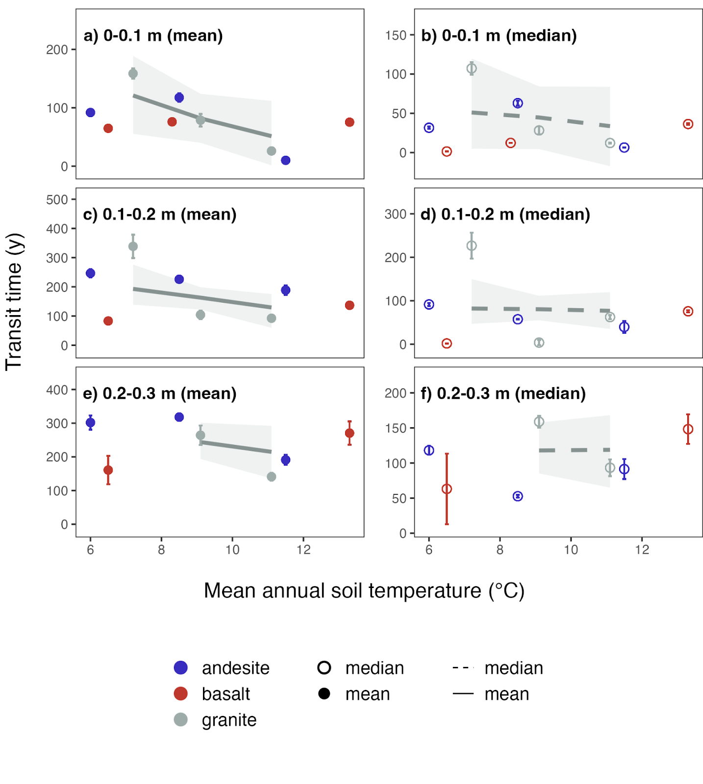
TEMPERATURE & TRANSIT TIME
transit time (y)

Slide 69
TEMPERATURE & TRANSIT TIME
transit time (y)

Slide 70
TEMPERATURE & TRANSIT TIME
Parent material has strong effect on temperature sensitivity of transit time
Expected relationship between temperature and transit time only apparent in granitic soils
transit time (y)

Slide 71
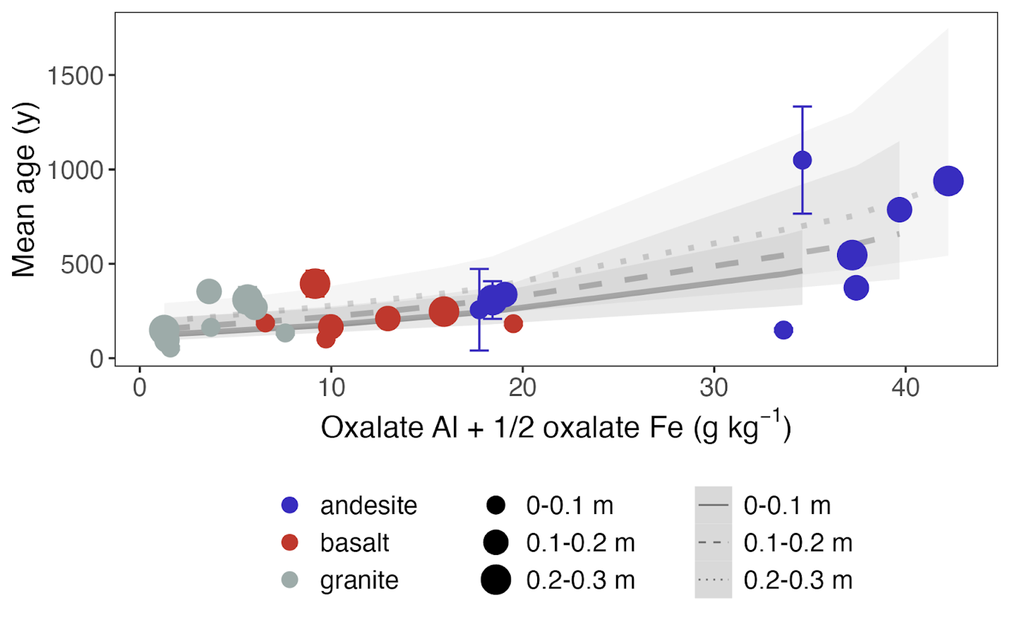
MINERALS & SYSTEM AGE
Notes:
we can explain the trends in mean age very well using the concentration of oxalate extractable Al and Fe, which is a good proxy measurement for the abundance of reactive secondary minerals, specifically the SRO iron and aluminum oxyhydroxides
Strength of the relationship increases with depth, which makes sense for two reasons:
1) The proportion of total layer carbon partitioned to the heavy fraction also increases with depth
2) The relative impact of temperature is buffered deeper in the soil---winter is not as cold, summer is not as hot
There was also a significant relationship for median age, which I am not showing because it was similar but not as strong

Slide 72
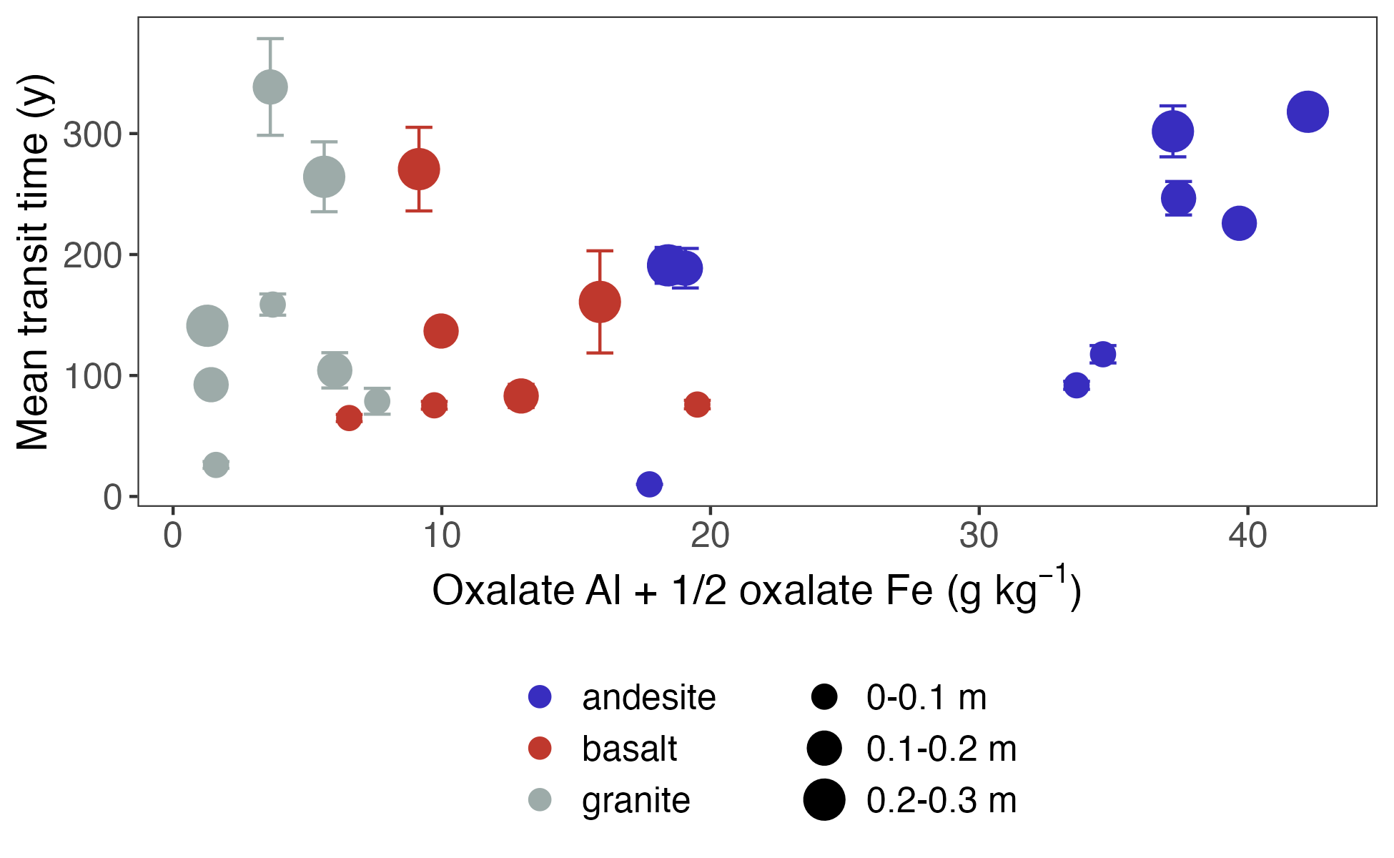
MINERALS & TRANSIT TIME
Notes:
When we look at transit time, however, we do not see a strong relationship with the oxalate extractable metal proxy

Slide 73
MINERALS & TRANSIT TIME
Notes:
However, if you squint, you can see that there is a trend for the basaltic and andesitic soils, at least if we ignore the surface soils (point out warm climate basalts)

Slide 74
MINERALS & TRANSIT TIME
Strong relationship between reactive mineral abundance and mean age
Relationship between oxalate extractable minerals and transit time weaker, and absent in surface and granitic soils
Notes:
However, if you squint, you can see that there is a trend for the basaltic and andesitic soils, at least if we ignore the surface soils (point out warm climate basalts)

Slide 75
RESULTS
Modellable vs.
Measurable
Notes:
For the next section of results I will talk about the density fraction data from the study sites, and address the conundrum of measuring the modellable and modeling the measureable

Slide 76
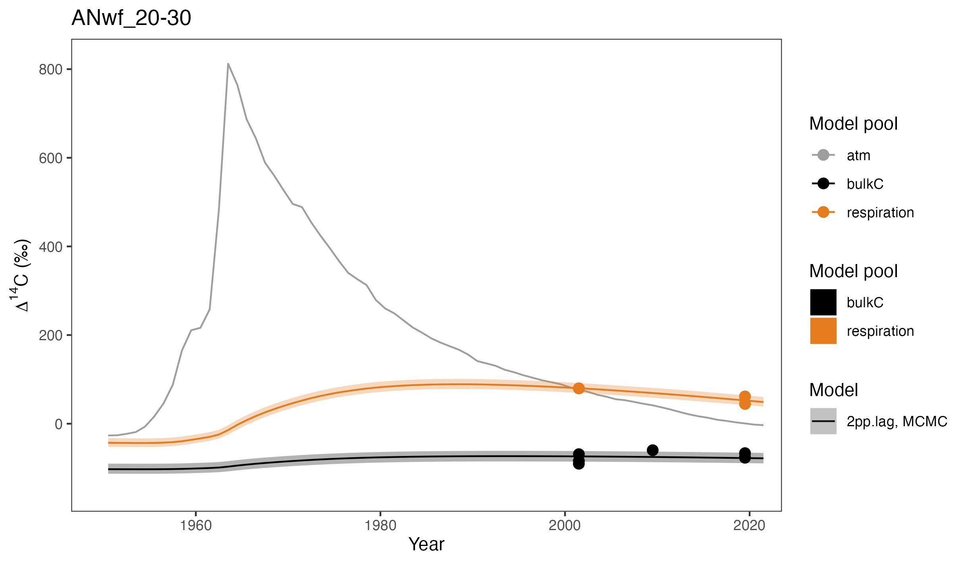
MODEL FIT + FRACTIONS
Cool climate andesite, 0.2-0.3 m
Notes:
OK, so let’s consider the 20-30 cm depth of the cool climate andesitic soil
As you can see, the 2-pool parallel model fits the data nicely
But what if we could use the fraction data to constrain the model pools?
Would this enable us to say something about the mechanisms of soil carbon persistence operating in the fast and slow model pools?

Slide 77
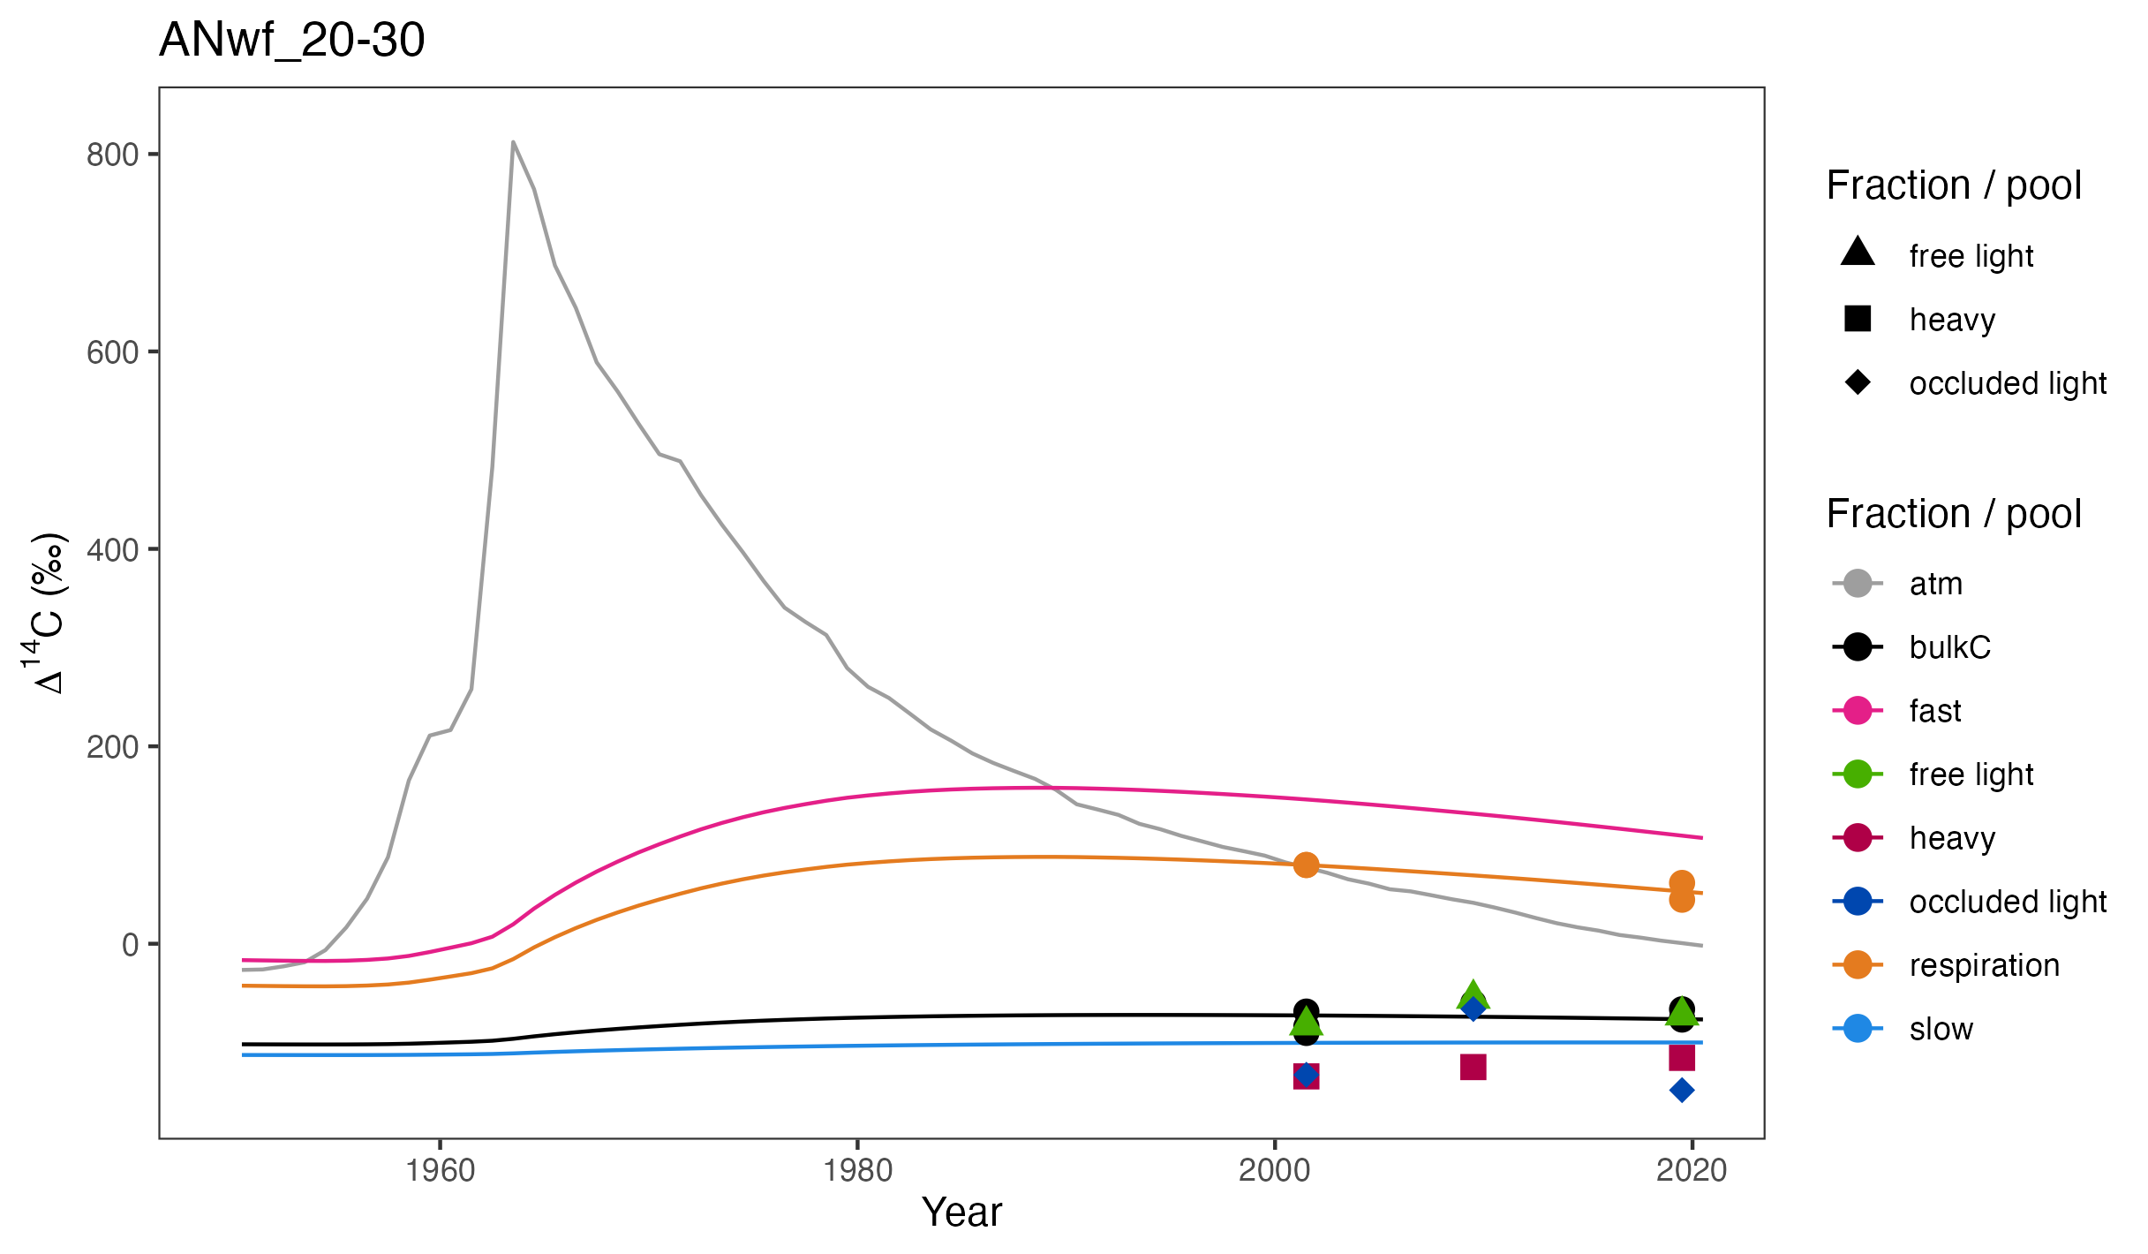
MODEL FIT + FRACTIONS
Cool climate andesite, 0.2-0.3 m
Notes:
Well the short answer is no.
I’ll ask you to put aside for a moment the fact that I’m comparing three fractions to two model pools, as I want to point out what I think are the greater fundamental issues with constraining soil carbon models with density fraction data
First of all, you can see that the fast pool and the respired 14C signal is much younger than any of the fractions
This is likely in part because the free light fraction from these sites---green triangles here---contain substantial amounts of charcoal
Other studies from this area have determined that the charcoal in these soils is very old
You can really see this when you look at the occluded light fractions, which also contain substantial amounts of charcoal.
In fact, when I inspected the occluded fractions under a light microscope it was obvious that they were mainly charcoal
[The other reason that the light fraction is older than we might expect is that I think it contains some degree of mineral-associated organic matter
How is that possible? Well, as you can imagine, if a dense clay particle is loaded with enough low density organic matter, there will be a point at which it floats in the heavy solution that is used to separate the fractions → since I used a density of 1.8, this is likely the case]
Second, you can also see that the heavy fraction samples are slightly older than the “slow” pool
This discrepancy was even more pronounced in some of the other soils
I should point out that when I tried to use the fractions to constrain the models I actually tried a number of 3-pool structures, but in no case was I able to get the time series to fit when constraining both pool sizes and radiocarbon signatures with the fraction data

Slide 78
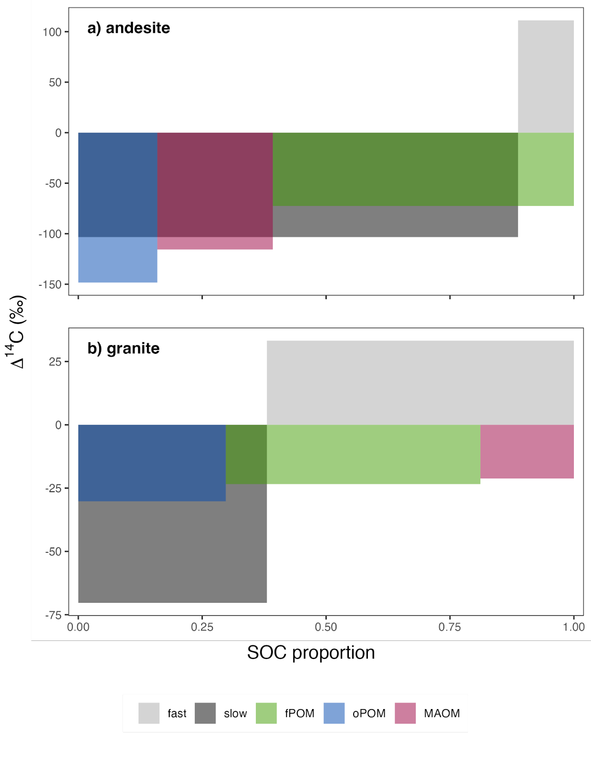
∆¹⁴C DISTRIBUTIONS
∆¹⁴C (‰)
Cool climate soils, 0.2-0.3 m, 2019
Notes:
To further illustrate this, we can overlay the carbon content and radiocarbon signature of the modeled pools with the measured fractions
As we saw in the time series, we can see that the fractions fail to capture the signal of the fast cycling pool, and that the slow pool appears to be a mixture of all three fractions

Slide 79
∆¹⁴C DISTRIBUTIONS
∆¹⁴C (‰)
Cool climate soils, 0.2-0.3 m, 2019
Notes:
If we consider the granitic soil from the same depth and year, we see that the fractions fair even more poorly
Here we miss the youngest carbon in the fast pool, but also miss the oldest carbon in the slow pool
Why is this? Well if you think back to the distributions I showed for soil carbon ages, you may remember that the mean values were skewed. And from an the empirical point of view we can only observe this mean value
In contrast, with the model we can obtain the full probability distribution function
If we explore the distribution of ∆14C within these gray boxes that correspond to the modeled pools, we see something like this:

Slide 80
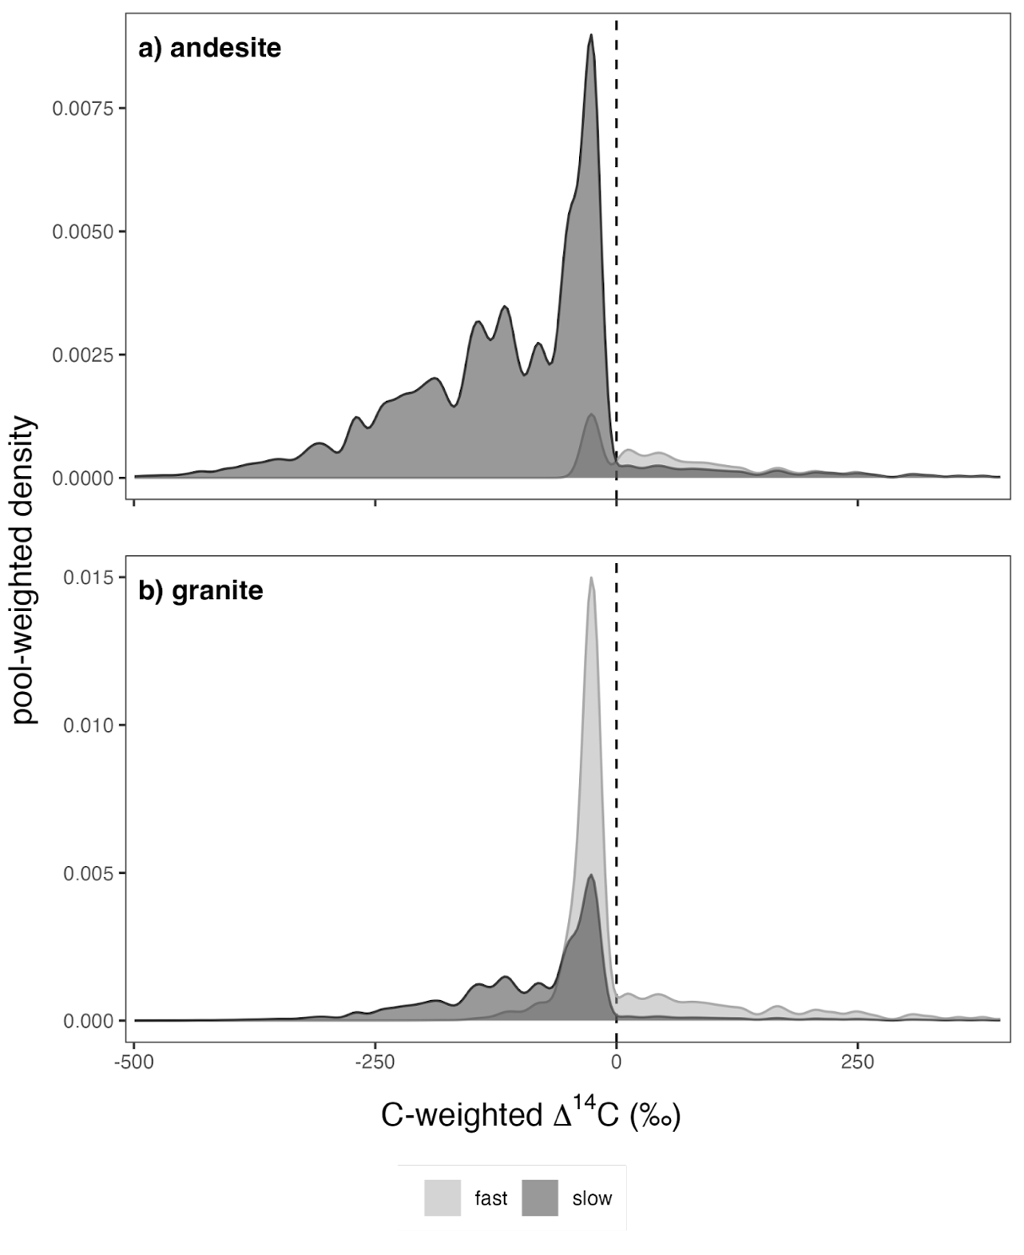
∆¹⁴C DISTRIBUTIONS: POOLS
density
overlap of slow and fast pools
Cool climate soils, 0.2-0.3 m, 2019
Notes:
Here you can see the long tail in the slow pool, but also the small proportion of modern carbon in the slow pool
And for the fast pool, you can see that the peak of the distribution is pre-modern, but the majority of the carbon is bomb-C

Slide 81
∆¹⁴C DISTRIBUTIONS: POOLS
density
Cool climate soils, 0.2-0.3 m, 2019
Notes:
And we can see the same resolution for the granitic soils
The peaks of the distributions for the fast and slow pools match what we observe in the fractions, but the fractions fail to capture the full spread of the data

Slide 82
OUTLOOK
&
CONCLUSIONS

Slide 83
OUTLOOK
500
250
Change in soil C stocks by 2100
(Pg C)
0
-250
-500
Ensemble of global soil C models
Model mean after adjusting temperature sensitivity (Q10)
Multi-model mean
± sd
(figure adapted from Todd-Brown et al., 2018)
Notes:
OK, let’s return to this figure from Todd-Brown et al.
So what can I apply from my PhD work to resolve the confusion present in the models?

Slide 84
OUTLOOK
inputs
+
500
250
Change in soil C stocks by 2100
(Pg C)
0
-250
-500
Ensemble of global soil C models
Model mean after adjusting temperature sensitivity (Q10)
Multi-model mean
± sd
(figure adapted from Todd-Brown et al., 2018)
Notes:
Let’s consider the effect of changes in inputs, and the persistence of those inputs, first

Slide 85
OUTLOOK
Relationship between soil mineralogy and transit time informs soil C response to shifts in inputs
Notes:
As I showed in the results section, soil mineralogy---specifically parent material---affected the estimated transit times
And this relationship can inform our expectations for changes in soil carbon stocks in response to changes in inputs

Slide 86
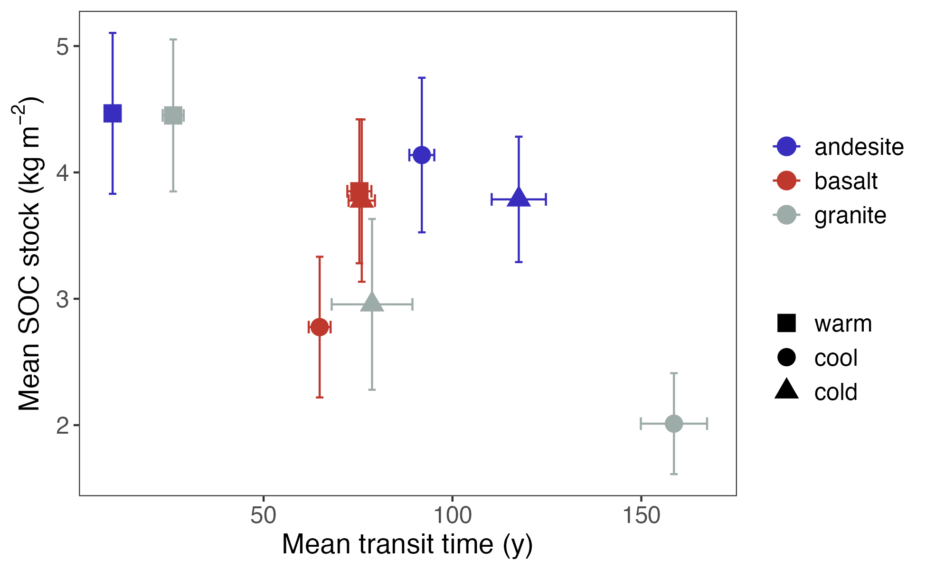
OUTLOOK
Relationship between soil mineralogy and transit time informs soil C response to shifts in inputs
Notes:
To illustrate this, we can see from this figure that in general, more carbon storage in soils is associated with faster cycling soil C, or faster transit times
However, we can see that this relationship is different among the different parent materials

Slide 87
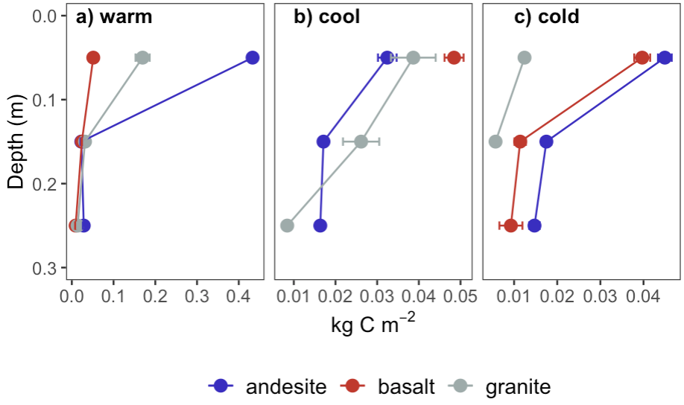
OUTLOOK
Soil C inputs
Notes:
I haven’t shown these data yet, but you may recall that I was able to estimate soil carbon inputs using the measured stocks and the fitted models
You can see that inputs decline consistently with increasing soil depth
But we can also see that climate has a strong influence on inputs

Slide 88
OUTLOOK
Soil C inputs
Notes:
Looking at the x-axis, you can see that the inputs for the surface layer of the warm climate sites are around an order of magnitude higher than for the surface layers in the cool and cold climate sites

Slide 89
OUTLOOK
cold
cool
warm
Notes:
So I want to present the results of a hypothetical experiment I conducted to assess the impact of potential temperature change on soil carbon inputs and in turn on soil carbon stocks
What will happen as our climate envelopes shift upward in elevation?

Slide 90
OUTLOOK
Can we predict soil C gains or losses in response predicted changes in the climate envelope?
cool
warm
Notes:
Can we predict soil C gains or losses in response to changes in soil C inputs?
To test this, I ran a simulation in which I increased inputs to the cool climate soils for both the granitic and andesitic sits to match those currently seen for the warm climate andesitic soil

Slide 91


OUTLOOK
cool -> warm
cool
warm
435 gC m⁻²
Notes:
In this figure the dashed line shows expected C sequestration at the current cool climate sites, while the solid line shows the expected gains with increased inputs

Slide 92
OUTLOOK
cool -> warm
+29
+19
cool
warm
435 gC m⁻²
Notes:
You can see that given the same inputs [435 grams of carbon per meter squared] we see larger gains in the andesitic soils which have longer transit times

Slide 93
OUTLOOK
cool -> warm
+29
+19
cold -> cool
cool
warm
435 gC m⁻²
Notes:
You can see that given the same inputs [435 grams of carbon per meter squared] we see larger gains in the andesitic soils which have longer transit times

Slide 94
OUTLOOK
500
250
Change in soil C stocks by 2100
(Pg C)
0
-250
+
decomposition
-500
Ensemble of global soil C models
Model mean after adjusting temperature sensitivity (Q10)
Multi-model mean
± sd
(figure adapted from Todd-Brown et al., 2018)
Notes:
OK, now let’s consider how what we’ve learned about the effect of soil mineralogy on the temperature sensitivity of decomposition may impact future soil carbon stock changes

Slide 95
OUTLOOK
cold
cool
warm
Notes:
Let’s return to this scenario in which our current climate envelopes are shifting upward

Slide 96
OUTLOOK
Can we predict soil C gains or losses in response to changes in decomposition rates?
cool
warm
Notes:
Now the question I want to ask is, “Can we predict soil C gains or losses in response to changes in decomposition rates?”
The idea here is that if rising temperatures have an impact on decomposition rates, one expectation is that future soil C dynamics at the current cold climate sites will shift to match what we see today at the cool climate sites
In order to isolate the effect of a potential shift in decomposition rates, I set the inputs for all sites to the level observed for the current cool climate andesite soil

Slide 97


OUTLOOK
a) andesite
+0.2
cool
warm
inputs = 31 gC m⁻²
Notes:
So for the andesitic soils, for which we did not observe any relationship between transit time and temperature, we do not see much of a change in soil carbon sequestration
[note that cool climate had slightly longer transit times]

Slide 98
OUTLOOK
a) andesite
+0.2
b) granite
-0.9
cool
warm
inputs = 31 gC m⁻²
Notes:
Turning to the granitic soils, we see a larger impact
Here we see that the cold to cool climate shift results in soil C losses
And this makes sense given the strong relationship I observed between transit time and mean annual temperature in these soils

Slide 99
OUTLOOK – FUTURE QUESTIONS
Notes:
So looking to the future, I identified a few questions that build on the findings from my PhD work

Slide 100
OUTLOOK – FUTURE QUESTIONS
How will pool-specific decomposition rates change? (For example, increases in turnover of the fast pool, but not the slow pool)
Further fractionation of density fractions could help answer this question
Notes:
thermal fractionation

Slide 101
OUTLOOK – FUTURE QUESTIONS
How will pool-specific decomposition rates change? (For example, increases in turnover of the fast pool, but not the slow pool)
Further fractionation of density fractions could help answer this question
What will happen to current “warm” climate sites?
Expand the range of sites considered to included warmer climate site
Notes:
Will we see a tipping point in soil moisture that leads to decreases in soil carbon inputs?

Slide 102
OUTLOOK – FUTURE QUESTIONS
How will pool-specific decomposition rates change? (For example, increases in turnover of the fast pool, but not the slow pool)
Further fractionation of density fractions could help answer this question
What will happen to current “warm” climate sites?
Expand the range of sites considered to included warmer climate site
What about soil C in deeper layers?
Find archives with deeper samples
New soil warming experiments

Slide 103
CONCLUSIONS
Soil mineralogy is critical for explaining ages & transit times – temperature alone is inadequate

Slide 104
CONCLUSIONS
Soil mineralogy is critical for explaining ages & transit times – temperature alone is inadequate
Transit time temperature sensitivity is moderated by mineralogical factors, i.e., mineral control matters for fast cycling soil C, too

Slide 105
CONCLUSIONS
Soil mineralogy is critical for explaining ages & transit times – temperature alone is inadequate
Transit time temperature sensitivity is moderated by mineralogical factors, i.e., mineral control matters for fast cycling soil C, too
Distributions of ages and transit times are more informative than means
Notes:
When it comes to empirical measurements, we need to ask ourselves whether or not the measurements represent homogenous pools or mixtures

Slide 106
CONCLUSIONS
Soil mineralogy is critical for explaining ages & transit times – temperature alone is inadequate
Transit time temperature sensitivity is moderated by mineralogical factors, i.e., mineral control matters for fast cycling soil C, too
Distributions of ages and transit times are more informative than means
Partitioning fast and slowly cycling mineral-associated soil C pools could improve predictions of future changes in soil C stocks

Slide 107
DeepSoil 2100 & SWEDDIE

Slide 108
WHAT IS DeepSoil 2100?
DeepSoil 2100: Global network of whole soil warming experiments
J. Beem-Miller
Notes:
All of the sites in the network were set up independently, and designed to answer specific questions
Largely united in the emphasis on constructing a carbon budget, but with different instrumentation, methodologies, and specific science questions
Can we gain a more nuanced, comprehensive understanding of which processes are affected in which settings? The first step is to create a synthesized database…

Slide 109
WHAT IS SWEDDIE?
DeepSoil 2100: Global network of whole soil warming experiments
SWEDDIE: Soil Warming Experiment to Depth Data Integration Effort (a database)
`
`
`
`
`
`
J. Beem-Miller
Notes:
All of the sites in the network were set up independently, and designed to answer specific questions
Largely united in the emphasis on constructing a carbon budget, but with different instrumentation, methodologies, and specific science questions
Can we gain a more nuanced, comprehensive understanding of which processes are affected in which settings? The first step is to create a synthesized database…

Slide 110
WHAT IS SWEDDIE?
DeepSoil 2100: Global network of whole soil warming experiments
SWEDDIE: Soil Warming Experiment to Depth Data Integration Effort (a database)
Comparative approach:
Model-data integration, coordinated sampling, benchmarking
J. Beem-Miller
Notes:
All of the sites in the network were set up independently, and designed to answer specific questions
Largely united in the emphasis on constructing a carbon budget, but with different instrumentation, methodologies, and specific science questions
Can we gain a more nuanced, comprehensive understanding of which processes are affected in which settings? The first step is to create a synthesized database…

Slide 111

WARMING EXPERIMENTS
Alpine forest
figure from M. Schmidt
J. Beem-Miller
Notes:
Of these sites, 7 have nearly identical design with resistance heating rods extending greater than 1 m into the soil:
Pt. Reyes, Blodgett, SPRUCE, SMARTX, SWELTR, ACBB, TEAM
A further 6 have some combination of resistance heating rods and infrared surficial heating
B4WARMED, BioCon, Harvard Forest, TRACE, Achenkirch, Sanming
Two sites have other mechanisms of heating, e.g., CIPEHR (snow removal) and FORHOT (geothermal)

Slide 112






WARMING EXPERIMENTS
J. Beem-Miller
Notes:
30% increase in CO2 production over the whole soil profile
Difference in top soil and subsoil processes

Slide 113

BLODGETT FOREST EXAMPLE
Blodgett Forest
+ 4 °C
(figure from Soong et al., 2021)
J. Beem-Miller
Soong et al., 2021. Five years of whole-soil warming led to loss of subsoil carbon stocks and increased CO2 efflux. Sci. Adv.
Notes:
Losses observed in subsoil
non-sig gains in top 20 cm
1/3 of SOC stocks after just 4 and half years of warming (3.21±1.0 kg C m−2)
Primarily particulate organic matter

Slide 114
BLODGETT FOREST EXAMPLE
Blodgett Forest
+ 4 °C
(figure from Soong et al., 2021)
J. Beem-Miller
Soong et al., 2021. Five years of whole-soil warming led to loss of subsoil carbon stocks and increased CO2 efflux. Sci. Adv.
Notes:
30% increase in CO2 production over the whole soil profile
Difference in top soil and subsoil processes

Slide 115

THE ROLE OF DEPTH?
(Fig. from Hicks Pries et al., 2023, DOI:10.1146/annurev-ecolsys-102320-085332)
J. Beem-Miller
Notes:
30% increase in CO2 production over the whole soil profile
Difference in top soil and subsoil processes

Slide 116

NEXT STEPS
Methods
∆¹⁴C
ecosystem respiration
lab incubations
modeling (ecosys, SoilR)
Sites
Blodgett (temp. forest)
B4WarmED (boreal/temp. forest)
ACBB (grassland/cropland)
SWELTR (tropical forest)
TEAM (permafrost)
J. Beem-Miller
Notes:
30% increase in CO2 production over the whole soil profile
Difference in top soil and subsoil processes

Slide 117

Thanks!
https://iscn.fluxdata.org/network/partner-networks/deepsoil2100/
Grassland Warming Experiment Site
Point Reyes, USA

Slide 118


DENSITY FRACTIONATION
“free light”
“occluded light”
mix soil (< 2mm) with heavy liquid
e.g., SPT @ 1.8 g cm⁻³
sedimentation
dispersion
e.g. sonication
“heavy”
(aka mineral-associated)
Figure adapted from Wagai et al. 2009
Notes:
So how do we quantify the amount of organic matter that persists due to interactions with soil minerals?
Density fractionation is one of the most common methods of doing this and relies on the difference in density between soil minerals and organic material
Organic matter bound to dense minerals will sink in a heavy solution, and can be separated from free floating organic matter, which we call the “free light fraction”
We can also separate organic matter found in soil aggregates, which are thought to promote soil carbon persistence, by dispersing these particles with high energy sound waves or glass beads. This is the occluded light fraction
[confirmed that I used 1.8 g cm-3, matching what was reported by Rasmussen et al., 2018]

Slide 119
HEAVY FRC ∆¹⁴C DISTRIBUTION
metal oxides
lipids/sugars
COOL
0.2-0.3 m
Clays
positive ∆¹⁴C = modern
Notes:
This figure shows the distribution of 14C within the mineral associated C pool for the three parent materials
Here we see clearly that the andesitic soils have two peaks, while the basaltic and granitic soils are unimodal, and the granite soil is mostly modern
decadal, centennial, millennial, respectively

Slide 120

PARALLEL vs SERIES
2-pool parallel
2-pool series
Age:
TT:
lag:
149 (96)
149 (102)
92 (35)
95 (32)
1
11
Notes:
put this as reserve

Slide 121
PARALLEL vs SERIES
2-pool parallel
2-pool series
Age:
TT:
lag:
149 (96)
149 (102)
92 (35)
95 (32)
1
11
Mean system age & transit time insensitive to model structure with only bulk and respired ∆¹⁴C constraints
Notes:
put this as reserve

Slide 122
OUTLOOK
a) cool -> warm
+29
+19
b) cold -> cool
cool
warm
14 gC m⁻² y⁻¹
32 gC m⁻² y⁻¹
Notes:
For the second scenario I shifted the inputs for the cold climate sites to match those currently estimated for the cool climate sites
In this scenario I didn’t use the same inputs for the granite and andesitic soils, but used the granitic soil estimates for the granitic soils and the andesitic soils estimates for the andesitic soils

Slide 123
OUTLOOK
a) cool -> warm
+29
+19
b) cold -> cool
+2.4
cool
warm
-0.6
14 gC m⁻² y⁻¹
32 gC m⁻² y⁻¹
Notes:
This results in a small decrease in inputs for the andesitic soils, and moderate increase for the granitic soils

Slide 124
FRACTION vs. RESPIRED ∆¹⁴C
free light
heavy
Notes:
put this as reserve

Slide 125

FRACTION vs. RESPIRED ∆¹⁴C
free light
heavy
Notes:
put this as reserve

Slide 126

LAG TIMES

Slide 127

SOIL MOISTURE
Notes:
granite transect

Slide 128
STUDY SITES
Basalt
Soil organic C stocks (0-0.3 m)
kg m⁻²
Warm
Cool
Cold
Andesite
Basalt | 8.8 (3.0) | 6.7 (0.6) | 6.4 (0.7)
Andesite | 13.0 (1.1) | 10.4 (2.9) | 10.1 (4.0)
Granite | 8.5 (1.3) | 6.0 (0.5) | 4.8 (0.1)
Granite
100 km
Data from Rasmussen et al., 2006 & 2018
Notes:
Differences in carbon storage
No big changes 2001-2019, i.e., steady-state

Slide 129

WETNESS INDEX & AGE
Notes:
Parent material highly correlated with system age, as is soil wetness (MAP - ET)
But can't separate wetness effect from PM

Slide 130
IMPORTANCE OF MINERALS
Predominant mechanisms of mineral-organic association varies by mineral
goethite
vermiculite
Data from Mikutta et al., 2007
Notes:
Well a simple explanation is that mineral-associated soil carbon is not a homogeneous pool
Soils contain a diverse array of mineral species, and these different minerals bind to soil organic matter via different mechanisms
These images show three examples of very physically different soil mineral species, although mineral-organic interactions are also strongly affected by the charge of the mineral particles and the presence of difference functional groups on the mineral surfaces
[arrow shows organic matter accumulation
missing for other minerals because of masking by gold particles during sample preparation prior to imaging]

Slide 131
IMPORTANCE OF MINERALS
Predominant mechanisms of mineral-organic association varies by mineral
goethite
vermiculite
Short-range order
2:1 clay
Data from Mikutta et al., 2007
Notes:
Well a simple explanation is that mineral-associated soil carbon is not a homogeneous pool
Soils contain a diverse array of mineral species, and these different minerals bind to soil organic matter via different mechanisms
These images show three examples of very physically different soil mineral species, although mineral-organic interactions are also strongly affected by the charge of the mineral particles and the presence of difference functional groups on the mineral surfaces
[arrow shows organic matter accumulation
missing for other minerals because of masking by gold particles during sample preparation prior to imaging]

Slide 132
IMPORTANCE OF MINERALS
Predominant mechanisms of mineral-organic association varies by mineral
Mineral type matters for soil C persistence
goethite
vermiculite
Short-range order
2:1 clay
 | Min-OM sorption type
 | Ligand exch. | Ca⁺⁺ & precip. | Van der Waals
goethite | 92% | n.d. | 8%
vermiculite | 7% | 78% | 14%
Data from Mikutta et al., 2007
Notes:
You can see this in this table here, which gives the relative importance of these three different sorption mechanisms for these three minerals
Well a simple explanation is that mineral-associated soil carbon is not a homogeneous pool
Soils contain a diverse array of mineral species, and these different minerals bind to soil organic matter via different mechanisms
These images show three examples of very physically different soil mineral species, although mineral-organic interactions are also strongly affected by the charge of the mineral particles and the presence of difference functional groups on the mineral surfaces
[arrow shows organic matter accumulation
missing for other minerals because of masking by gold particles during sample preparation prior to imaging]

Slide 133
2-PP vs 2-PS MODELS
Out
a) Parallel
𝜏_{fast}: 17 (12) y
𝜏_{slow}: 161 (111) y
Age: 149 (96) y
TT: 92 (31) y
Lag: 1 y
(49)
48%
(388)
23.5
In
fast: 48%
slow: 52%
52%
25.5
(4119)
Out
b) Series
𝜏_{fast}: 10 (2) y
𝜏_{slow}: 176 (107) y
Age: 149 (102) y
TT: 95 (33) y
Lag: 11 y
(39)
100%
(401)
15.2
In
fast: 39%
slow: 61%
61%
23.8
(4160)

Slide 134

STUDY SITES
Notes:
North to south parent material gradient, climate gradient east to west
All conifer dominated
timeseries of ∆14C
respired = laboratory incubations

Slide 135
BAYESIAN LINEAR MODELS
Mineral model:
$$\ln\left(μ_{i}\right)= β_{0}+ β_{ox} ∙ {OX}_{i}+ β_{d} ∙ d_{i}+ β_{ox}β_{d} ∙ {OX}_{i} ∙ d_{i}$$
Temperature model:
$$μ_{ij}= β_{0_{j}}+ β_{T_{j}} ∙ T_{i}+ β_{d} ∙ d_{i}+ β_{d}β_{T} ∙ T_{i} ∙ d_{i}$$
Notes:
North to south parent material gradient, climate gradient east to west
All conifer dominated
timeseries of ∆14C
respired = laboratory incubations

Slide 136
BAYESIAN LINEAR MODELS
Mineral model:
$$\ln\left(μ_{i}\right)= β_{0}+ β_{ox} ∙ {OX}_{i}+ β_{d} ∙ d_{i}+ β_{ox}β_{d} ∙ {OX}_{i} ∙ d_{i}$$
Al_{ox} + ½ Fe_{ox}
depth
interaction
Notes:
North to south parent material gradient, climate gradient east to west
All conifer dominated
timeseries of ∆14C
respired = laboratory incubations

Slide 137
BAYESIAN LINEAR MODELS
Temperature model (hierarchical):
$$μ_{ij}= β_{0_{j}}+ β_{T_{j}} ∙ T_{i}+ β_{d} ∙ d_{i}+ β_{d}β_{T} ∙ T_{i} ∙ d_{i}$$
j₁ = parent material₁
temperature
depth
interaction
Notes:
North to south parent material gradient, climate gradient east to west
All conifer dominated
timeseries of ∆14C
respired = laboratory incubations

Slide 138

SIERRA SITES MINERALOGY
Data from Rasmussen et al., 2018
Notes:
North to south parent material gradient, climate gradient east to west
All conifer dominated
timeseries of ∆14C
respired = laboratory incubations

Slide 139

IMPORTANCE OF MINERALS
Global distribution of C in fractions (<0.3 m)
Fraction
free light
heavy
% of bulk C
Figure adapted from Heckman & Hicks-Pries et al. 2021
Notes:
So the figures on the right are from a global study I was involved with where we looked at the distribution and radiocarbon content of density fractionations, with the goal of quantifying the importance of mineral-associations for soil carbon persistence and accumulation

Slide 140
IMPORTANCE OF MINERALS
Majority of soil C is mineral-associated (“heavy”)
Global distribution of C in fractions (<0.3 m)
Fraction
free light
heavy
% of bulk C
Figure adapted from Heckman & Hicks-Pries et al. 2021
Notes:
So we see from the figure that the majority of soil organic matter is found in association with minerals
Carbon concentrations are usually lower in heavy fractions, but there is more carbon there overall

Slide 141
IMPORTANCE OF MINERALS
Majority of soil C is mineral-associated (“heavy”)
Some mineral-associated C very old…
Global distribution of ∆¹⁴C in fractions (<0.3 m)
Fraction
free light
heavy
∆¹⁴C
Figure adapted from Heckman & Hicks-Pries et al. 2021
Notes:
Turning to radiocarbon, we also see differences between the fractions
What we can see in this figure is that very old (very negative ∆14C values) mineral-associated C occurs in some soil, but globally, the heavy fraction C is surprisingly young
You can see this from the median – dotted line – which is just below zero

Slide 142
IMPORTANCE OF MINERALS
Majority of soil C is mineral-associated (“heavy”)
Some mineral-associated C very old…
…but ca. 50% of mineral-associated C is “modern” (i.e., contains bomb C)
Global distribution of ∆¹⁴C in fractions (<0.3 m)
Fraction
free light
heavy
∆¹⁴C
>10² y
”modern”
Figure adapted from Heckman & Hicks-Pries et al. 2021
Notes:
This tells us that mineral mineral associated soil organic matter contains quite a bit of bomb-C, and therefore must be turning over on decadal timescales
[n ~1200-1400]

Slide 143
STUDY 1: OVERALL RESULTS

Slide 144
STUDY 1: STORAGE EFFECTS

Slide 145
STUDY 1: HAINICH

Slide 146
STUDY 1: PRE-INC EFFECT

Slide 147
∆¹⁴C RESPIRED vs BULK

Slide 148
∆¹⁴C vs REACTIVE MINERALS

Slide 149
SOIL ORGANIC C STOCKS

Slide 150

STUDY 3: MODEL FITS (0-0.1 m)

Slide 151

STUDY 3: MODEL FITS (0.1-0.2 m)

Slide 152

STUDY 3: MODEL FITS (0.1-0.2 m)

Slide 153
STUDY 3: MAT & SYSTEM AGE

Slide 154
STUDY 3: MAT & TRANSIT TIME

Slide 155

STUDY 3: DEPTH DEPENDENCE

Slide 156

STUDY 3: MODEL SOIL C STOCKS
2-pool parallel model

Slide 157

SYNTHESIS: FRACTION ∆¹⁴C

Slide 158

WELL-MIXED? OR LONG TAIL?
0-0.1 m
a) andesite
b) granite
log (TT)
log (age)
Notes:
quartiles of the age and transit time distributions, bottom left point is 25th quartile, upper right is 75th
granite is generally well mixed, and especially for the cold climate site, behaves like a one pool system
long tail evident in the hook of the 75th quartile
missing for the cold climate site, possibly because soils are not as well developed (lower concentrations of poorly crystalline minerals)

Slide 159
BULK SOIL ∆¹⁴C
0-0.1 m
257
102
54
∆¹⁴C
older
younger
Notes:
MAT relationship: strongest for GR, weak for BS, bizarre for AN
[gradient with climate colors]

Slide 160
BULK SOIL ∆¹⁴C
0-0.1 m
1049
183
134
∆¹⁴C
much older
–––– younger ––––
Notes:
MAT relationship: strongest for GR, weak for BS, bizarre for AN

Slide 161
BULK SOIL ∆¹⁴C
0-0.1 m
149
187
163
∆¹⁴C
no gradient
Notes:
MAT relationship: strongest for GR, weak for BS, bizarre for AN

Slide 162
RESPIRED ∆¹⁴C-CO₂
0-0.1 m
younger
older
younger
∆¹⁴C
10
75
26
Notes:
AN has shortest TT!

Slide 163
RESPIRED ∆¹⁴C-CO₂
0-0.1 m
older
–––– younger ––––
∆¹⁴C
118
76
79
Notes:
AN oldest TT, but not by much

Slide 164
RESPIRED ∆¹⁴C-CO₂
0-0.1 m
older
younger
oldest
∆¹⁴C
92
65
159
Notes:
GR oldest despite lack of gradient in ages

Slide 165
INCUBATIONS

Slide 166

INCUBATIONS

Slide 167
INCUBATIONS

Slide 168

INCUBATIONS

Slide 169
INCUBATIONS

Slide 170

INCUBATIONS

Slide 171

STUDY SITES
Poorly crystalline mineral abundance (Al_{ox} + ½ Fe_{ox}) in the continental United States
Data from Slesserav et al., 2022
Notes:
red = primary mineral derived
blue = secondary mineral derived

Slide 172


WEATHERING & PCMs
Data from Slesserav et al., 2022
Notes:
relationship between PCM abundance and SOC stocks strongest in humid climates with strong weathering potential, but only if adequate primary mineral stocks remain to fuel transformation of primary minerals into reactive secondary mineral products
influence of PCMs on SOC abundance (and C cycling rates) strongest at local or regional scales

Slide 173

WEATHERING & PCMs
Data from Kramer and Chadwick, 2018
Notes:
relationship between PCM abundance and SOC stocks strongest in humid climates with strong weathering potential, but only if adequate primary mineral stocks remain to fuel transformation of primary minerals into reactive secondary mineral products
influence of PCMs on SOC abundance (and C cycling rates) strongest at local or regional scales

Slide 174
WEATHERING & PCMs
Range of MAP-PET in this study
Data from Kramer and Chadwick, 2018
Notes:
DOC extracted with pyrophosphate-dithionite (crystalline + non/poorly crystalline forms)
St

Slide 175

GLOBAL C BUDGET
(figure from Friedlingsten et al., 2022)
Notes:
point out decrease in land use change emissions

Slide 176

LAND C FLUX PREDICTIONS
emissions pathways
(figure from IPCC AR6, 2023)

Slide 177
SOIL C CHANGES
500
250
0
-250
-500
(figure adapted from Todd-Brown et al., 2018)

Slide 178
SOIL C INPUTS VS LOSSES
inputs
+
500
250
Change in soil C stocks by 2100
(Pg C)
0
-250
-500
+ decomposition
Ensemble of global soil C models
Model mean after adjusting temperature sensitivity (Q10)
Multi-model mean
± sd
(figure adapted from Todd-Brown et al., 2018)
J. Beem-Miller
Notes:
30% increase in CO2 production over the whole soil profile
Difference in top soil and subsoil processes

